Slide 1

St Patrick’s Catholic Primary School
Meet the Teachers
Mrs Solomon and Mrs Courtney
Welcome to year 2
2026-2027
“Live, Love and Learn like Jesus”
Notes:
Mrs Solomon

Slide 2
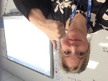

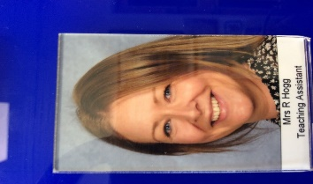
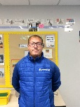
Our Wonderful Year 2 Team
Class Teacher
Mrs Solomon
Monday and Tuesday and Wednesday
Mr Cross
Wednesday – 1 hour and a half
Class Teacher
Mrs Courtney
Thursday and Friday
Support Staff
Mrs Hogg
Mrs Turner
Mrs Clermont
Notes:
Mrs Solomon

Slide 3
Here is an outline of what we will be teaching in the first term:
Maths and mastery maths – Place Value, Addition and Subtraction (0-100).
English – Focus on story writing, time connectives, conjunctions, expanded noun phrases and handwriting
Phonics – Recap of phase 5 (practising all of the alternative sounds, segmenting and blending).
Science - Growth and Survival
Religion – Mission, Creation and Harvest as well as connecting to other faiths. Life to the Full- this will be put on Google Classroom.
History – A walk through history (History of Corsham).
Art – Self portraits
PSHE – Life to the Full Plus- Feelings and Healthy Bodies
P.E – developing and applying a range of footwork and one leg balances through cooperative and competitive games. Developing Ball Skills (sending and receiving).
Notes:
Mrs Courtney

Slide 4

Key Stage One:
End of year expectations/ targets for Year 2
Please follow these links to learn more about the end of year expectations for English and Maths.
English - https://assets.publishing.service.gov.uk/government/uploads/system/uploads/attachment_data/file/335186/PRIMARY_national_curriculum_-_English_220714.pdf
Maths –
  https://assets.publishing.service.gov.uk/government/uploads/system/uploads/attachment_data/file/335158/PRIMARY_national_curriculum_-_Mathematics_220714.pdf
Notes:
Mrs Courtney

Slide 5
Assessment and Recording
We use a variety of summative and formative assessments to ensure every
child makes progress along their personal learning journey. Within the Stage that the pupils are working on we assess whether pupils are:
Working Below Expectations, Working towards expectations, Meeting Expectations & Exceeding Expectations.
ATTAINMENT – It is not expected that pupils will be Meeting Expectations until summer term,
however, we will be able to report to you during the year whether or not your child is on track to meet expectations. All children are tested against the National Curriculum objectives. These tests will be in Reading and Maths. Writing will continue to be teacher assessed against national expectations.
If your child didn’t pass the phonics test in Year 1, they will be tested again in
June (and informally at various stages during the year).
PROGRESS – This looks at each individual’s starting points.
Notes:
Mrs Courtney

Slide 6




Our English lessons are based on quality texts such as Stories From The Billabong and The Koala who Could by Rachel Bright.
We start each English sequence off by starting with a hook to engage the children and then use the book to pick out key features of the text, e.g. expanded noun phrases, questions, exclamation sentences, the use of nouns, verbs, adverbs, etc so that the children can create links and see how they are used in a familiar text. We have a different writing focus each term (fiction and non fiction) and will be writing for a range of purposes – keep an eye on the website curriculum page to find out what we are covering each term.
Notes:
Mrs Courtney

Slide 7


Reading
Please use the green Reading Record to comment on your child’s reading and you could note any concerns there too.
Children who move off the phonics reading scheme will be encouraged to change their own reading book and to choose their next book within their reading level. Your child will need to let us know if they have finished their book as these may take longer to complete by the following Monday.
ENJOY lots of books. We want all children to have a passion for reading.
Your child is expected to take home their book everyday to read.
Your child is expected to have their reading book in school every day.
Phonics books will be changed every Monday by the children but supervised by an adult. Parents are encouraged to ensure that their child reads and re-reads their book to aid fluency and comprehension.
Notes:
Mrs Courtney

Slide 8

Guided Reading:
To use a range of strategies to read new words (blending, segmenting, picture clues, context).
To select and retrieve information (to be able to answer questions).
To be able to interpret events and information using evidence from the text (use of inference).
To give opinions about the text with reasons.
To comment on language choices, patterns in words, general features of a text, how the book is set out.
To be able to predict what might happen in a story and retell the story.
Notes:
Mrs Courtney

Slide 9
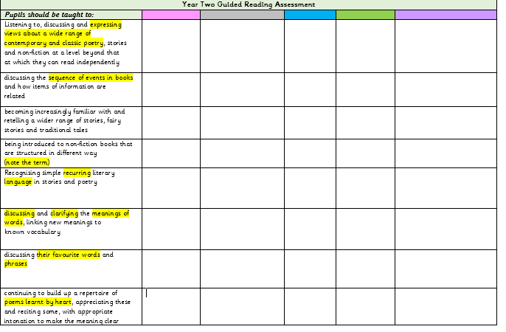
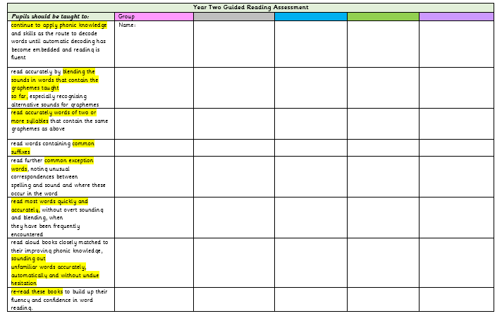
Guided Reading Assessment
Notes:
Mrs Solomon

Slide 10


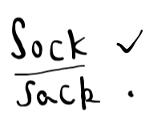
Our notes in the reading records
Notes:
Mrs Solomon

Slide 11
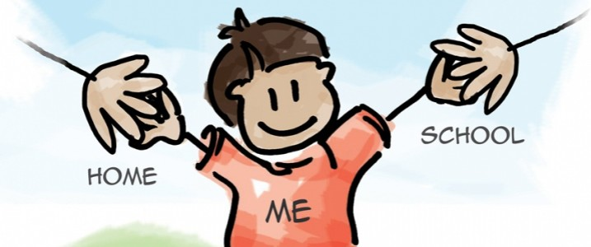
Reading: Parent Partnership
As part of your reading time, talk about the book. Ask questions to develop understanding and extract information.
Explain the importance of re-reading the story book your child has.
Talk about new words and what they mean.
Share lots of different types of books – non-fiction, poetry and stories.
Look all around for opportunities to read for information.
Join/ visit the library, look out for special events at the library ….
Do anything that encourages your child to read and makes reading fun!
Notes:
Mrs Courtney

Slide 12
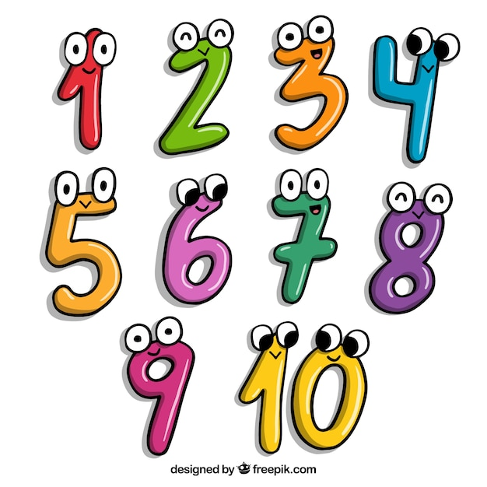
Maths: Parent Partnership
Learning is a partnership and one of the great ways you can help is by assisting the children to learn first of all the pairs of numbers that make 20 and possibly to make a hundred. 14,6 8,12 13,7 >>>>> 30 +70 35 and 65
Telling the time is also something that you can particularly help with at home. O’clock, half past, quarter past then quarter to the hour. You will need an analogue clock!
Notes:
Mrs Solomon

Slide 13

Spellings: Parent partnership
Spellings are linked to Phonics lessons, topic key vocabulary and the Year Two Common Exception words
Find out which of the spellings your child already knows.
Practise writing the spellings in sentences as this helps your child to transfer the knowledge into their everyday writing.
We are working with the children so that they know the Year 2 Common Exception words
Thank you!
Notes:
Mrs Solomon

Slide 14
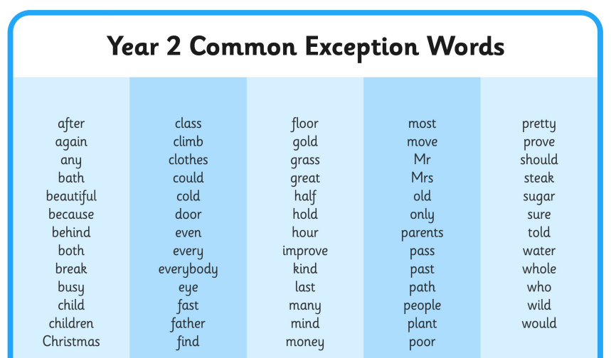
Notes:
Mrs Solomon

Slide 15


Home Learning
Reading
Spellings
TT Rockstars
Notes:
Mrs Courtney

Slide 16
Other Information
Named clothing
Absence
Marvellous Marbles
Handwriting
Communicating with Mrs Solomon/ Mrs Courtney
Regular hand washing and/or sanitising.
We are teaching the children good hygiene routines (such as catch it, bin it, kill it, hand washing after sneezing, coughing into elbows etc).
PE kits to be worn on Wednesday and Thursday.
Please remember water bottles and to label them.
Notes:
Mrs Solomon

Slide 17

If you have any questions or concerns at any point during the year, please CONTACT US STRAIGHT AWAY!
Thank you very much for joining us ☺
Notes:
Mrs Solomon

