Slide 1
Year 3 Curriculum Afternoon
Mrs OBORNE
Monday 5th october 2026.
Welcome!
Please sign in next to your child’s name on the list as the clipboard comes around. Please advise permissions on photos for Google Classroom or the school website so I have the most up to date information.

Slide 2
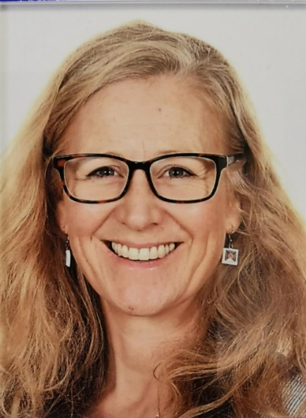

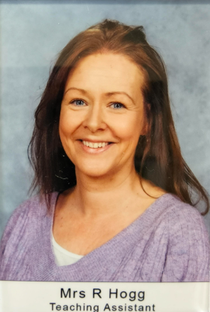

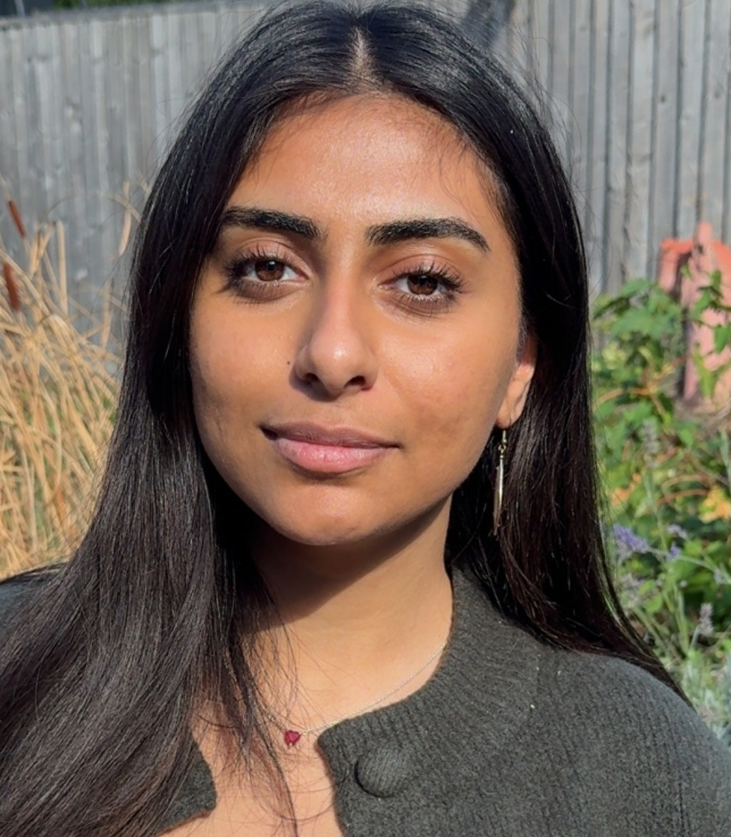
MEET THE Y3 TEAM
Mrs Oborne
Monday to Friday
KS2 Gate Duty Wed 8:40am
Miss Ahmed
4 days per week until Christmas break
Mrs Hogg
Monday and Tuesday
Mrs Pillinger
Wednesday, Thursday, Friday
Mr Cross
Tuesday 9am to 11:40am

Slide 3

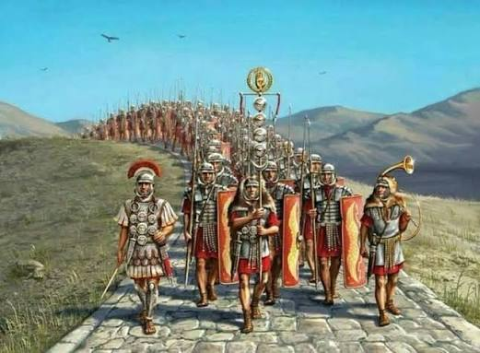
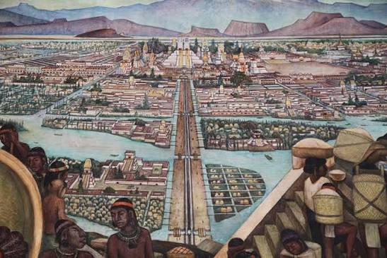
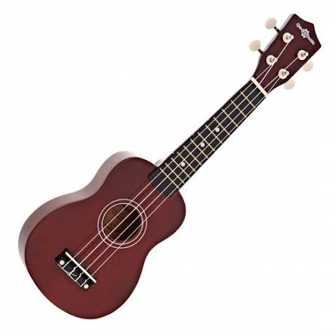
A bit about me…
New Zealand trained teacher
Teaching for 28 years (6 years in NZ, 1 year in Australia, 21years in UK)
Taught every age group, but really love LKS2!
Curriculum Specialisms:
Maths, Reading and Writing
Science (Subject Leader)
Passionate about History and Geography
(Year 3 topics: Romans, Wales, The Stone Age, Rivers,
Aztecs, Africa)
Ukulele! (Term 6)

Slide 4
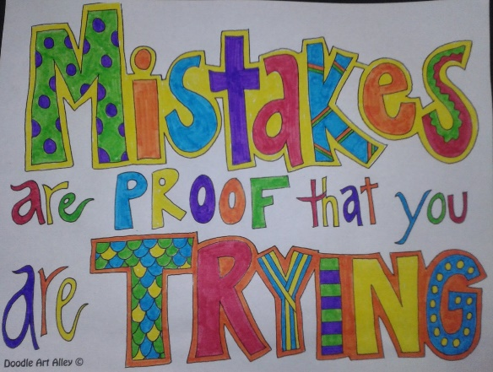
Year 3 Expectations
Increased independence in KS2
Non-negotiables in all book work
‘Learning to learn’ (Gem Project).
Asking questions.
Listening to each other.
Learning partners, seating plan.
Class motto – “It’s OK to make mistakes because we are learning”
Being resilient – keep going even when things get hard
Making good choices, following our Class Rules

Slide 5

Our Class RULES
Written by Year 3

Slide 6





The GEM Project - encouraging positive learning behaviours
Ruby: Supporting each other. Listening to each other and giving praise.
Diamond: Problem solving, being responsible.
Emerald: Sticking with it, even when it gets tough. Knowing that making mistakes is part of new learning.
Sapphire: Keeping focused. Ignoring distractions.
Topaz: Learning in a larger group. * Current focus
Amethyst: Working with a partner.

Slide 7
Assessment and Recording
We use a variety of assessments to ensure every child makes progress on their personal
learning journey. Within the Stage that the pupils are working on, we assess whether pupils are
Working Below Expectations, Working towards expectations, Meeting Expectations, or
Exceeding Expectations
ATTAINMENT – It is not expected that pupils will be Meeting Expectations until the summer term,
however, we will be able to report to you during the year whether or not your child is on track
to meet expectations.
PROGRESS – This looks at each individual’s starting points. We strive to ensure that each child
makes progress from their starting point over the year.

Slide 8


Slide 9
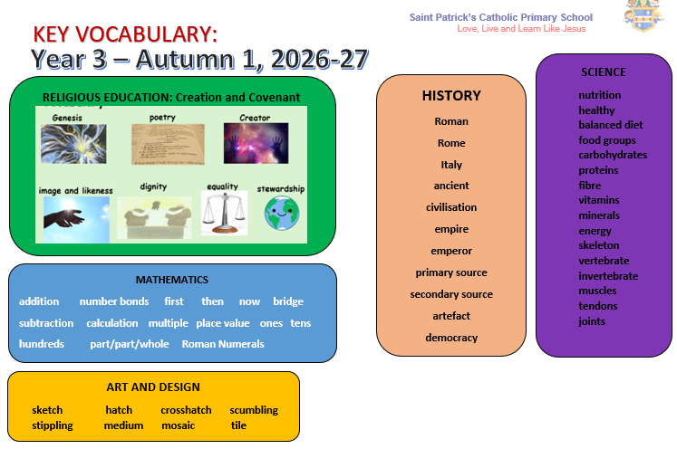

Slide 10

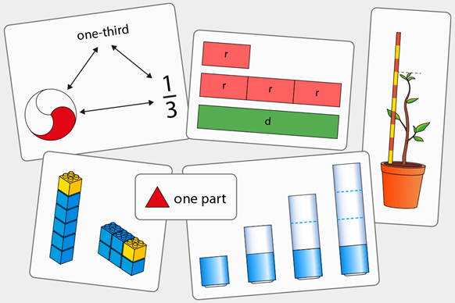
Mathematics
We follow the White Rose maths programme which has been developed by specialists and is guided by the following principles:
Coherence
Lessons are broken down into small connected steps that gradually unfold the concept, providing access for all children and leading to a generalisation of the concept and the ability to apply the concept to a range of contexts.
Representation and Structure
We use lots of practical equipment and concrete resources to help to embed the understanding and see the patterns and patterns before moving on to abstract calculations.
We are working with numbers up to 1000. We are also teaching children more formal methods of recording.
How you can help:
It is important that pupils know ‘Key Instant Recall Facts’. Practice using calculations, counting and sequencing numbers.
Real-life opportunities for maths; telling the time, money, cooking, measuring
Number bonds to 10/20/100
Times tables facts for x2, x5, x10, (should be known from Year 2) moving on to x3, x4, x8 (and inverse division facts)
Professor Assessor/TT Rock Stars – sometimes there will be a set task on PA to complete

Slide 11
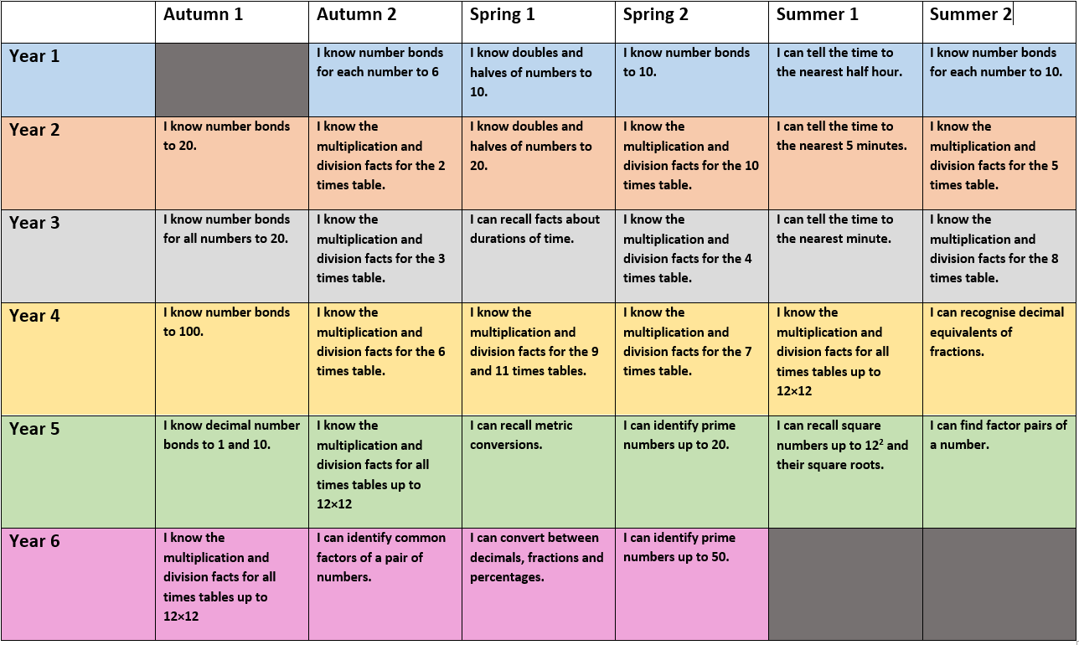
Key instant recall facts

Slide 12
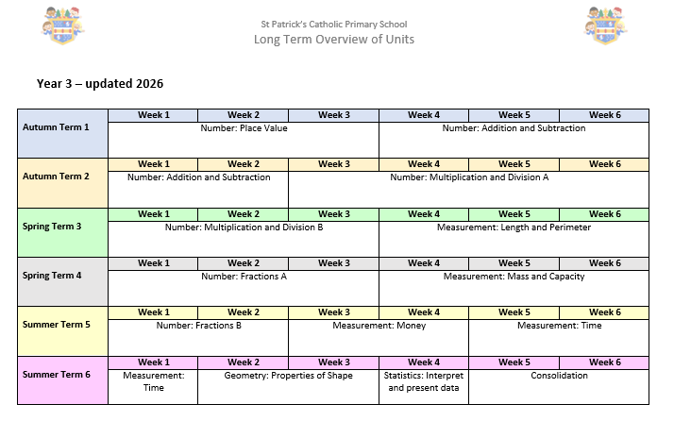

Slide 13


English Skills:
Writing in accurate sentences
Punctuation
Grammar
Reading
-Decoding (‘Unlocking letters and sounds’ phonics scheme if needed)
-Comprehension is key! (Use VIPERS bookmark to help you discuss the book at home)
-Passion and enjoyment – read their school book but also any other books that they enjoy
-VIPERS – Vocab, Infer, Predict, Explain, Retrieve, Sequence/Summarise
Handwriting
-’Unlocking letters and sounds’ handwriting scheme for all
-Formation – size and shape
-Fluency – building to/embedding cursive style and handwriting pens
Spelling
-‘Unlocking letters and sounds’ spelling scheme and strategies
-Supported with Home Learning
- Y3/4 Statutory spelling list

Slide 14

THE IMPORTANCE OF TALKING!
Think, Pair, Share
Regular change of learning partner
Flexible groupings
Oral language – Show and Tell day every week
(Feel free to send me photos or videos to share via email or Google Classroom)

Slide 15
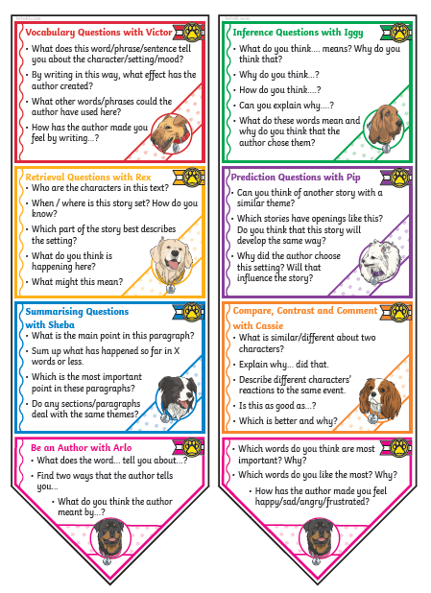
Reading
Reading In School
Reading records need to be in school each day
Children will be heard once a week in Guided Reading sessions with
the teacher. We will be working on a group text in these sessions.
There will be further opportunities throughout the week for them to be
heard by an adult.
If the child needs their book changed they can tell an adult and
then change their book during Guided Reading time.
Reading at home
Where possible, please listen to your child at least 3-4 times a week.
Please record any reading in the reading record
(children can record the date and book title for you, just add a comment)
Please talk to your child about what they are reading - see questions
on Reading Bookmarks
Developing a passion for reading is key!

Slide 16

reading for meaning

Slide 17

Spelling and Handwriting
Spelling and Phonics
Extra phonic support will be provided for those who need it.
- Pupils are taught clear spelling rules and strategies each week in 3x 20 minute sessions. The rule/strategy will be shared with you on the Home Learning.
Friday spelling test. Children must learn the blue words, can learn the trickier red words and can even choose purple ‘extra for expert’ words if needed, or work through the Year 3/4 statutory word list.
Handwriting
Our current focus is to ensure everyone is forming letters correctly and sizing them correctly. Then we work towards joining letters, ensuring the joins are in the right place.
Please correct missing or unnecessary capital letters.
Use their Spelling Look, Cover, Write, Check sheet for practising neat, well-formed handwriting each night.

Slide 18
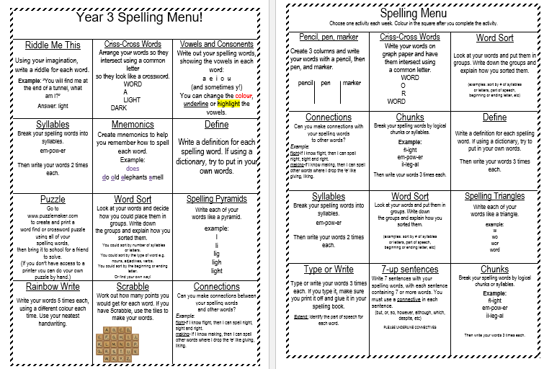
Spelling menu:
Pop on the fridge at home; there are lots of ways to help learn new spellings! Feel free to incorporate these into Spelling Home Learning if they are helpful and your child enjoys them. They could do one of these on the back of the spelling sheet.

Slide 19
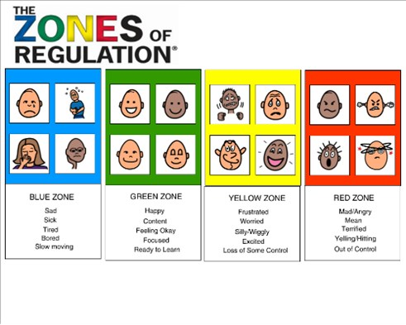

Slide 20
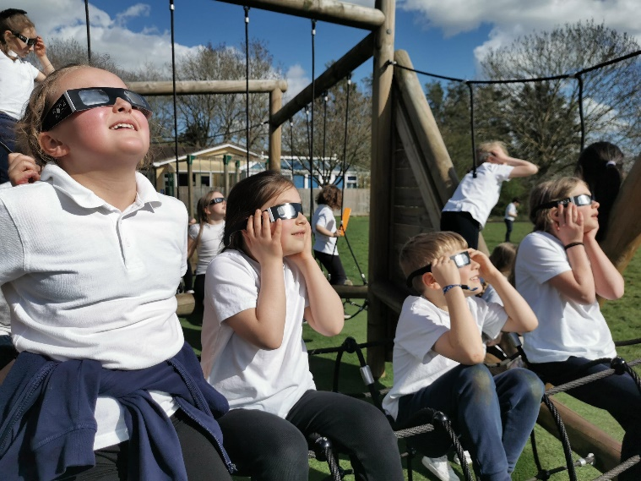
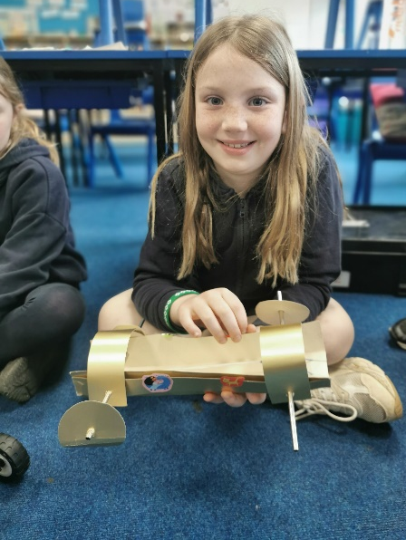
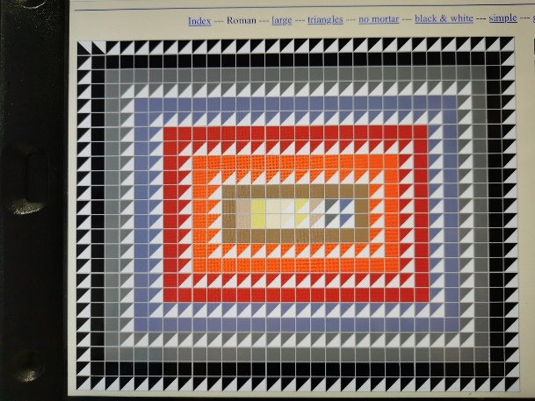
Home learning
Designed to support learning that goes on at school.
Set on a Friday, usually due the following Friday.
Uploaded to Google Classrooms- hard copies sent home if
you are not yet on Google Classroom
Children will be set weekly:
1) Spelling Practice – paper copies will be sent home on a Friday.
2) Times Table or Key Instant Recall Fact Practice (Professor Assessor and TT Rock Star logins are in their green Reading Records)
3) Reading – discussion is KEY. Are they understanding what they have read? Is there new vocabulary that needs explaining? Can they tell you about what has happened so far? (Use bookmarks to help)
4) Enrichment tasks – these often support our topic work and provide opportunities for research, mini projects, a game, a video to watch or creating a piece of Art.

Slide 21

Key INFORMATION
PE every Tuesday and Wednesday this term
Swimming on Wednesday: final swim Wed 14th Oct.
Pupils gain house points for their house team (House point cards).
Water bottles - Pupils are encouraged to drink water in class.
Please name all personal belongings.
If you have anything you would like to ask about, please do speak to us at the end of the day or speak to the office to arrange a phone call or meeting. My door is always open! (Staff meetings happen every Wednesday after school.)
Please keep us updated if someone else is collecting your child.
Important dates: Parents Evening next week (13th and 15th October)
Trip to Corinium Museum in Cirencester January 2027
(Romans and Stone Age artefacts)

Slide 22


Thank you for coming!

