Slide 1

Year 5 Curriculum Afternoon
“Live, Love and Learn like Jesus”
‘Curiosity is the engine of achievement,’ Sir Ken Robinson
Our door is always open. Please see us if you have any worries or concerns or….good news! Miss Wilkinson and Mrs Valentine.
Also any help is gratefully received – reading volunteers? Please see me for a chat.

Slide 2
Important Information
PE is on Tuesday and Thursday so please ensure your child comes into school wearing their smart P.E uniform
Please try to ensure your child is well rested; has a water bottle; lunch order or packed lunch; a reading book they enjoy (comics/graphic novels, magazines etc on Fridays only) and a good attitude!
Home learning:
Reading aloud for fluency and talking about the meaning of the text.
Professor Assessor Home learning task
Spelling and handwriting sheet – Read the word and understand the word. Handwrite and spell.
Swimming begins later in the year - Helpers are appreciated- please sign up.
Class assembly TBC
Thank you for listening – any questions?

Slide 3


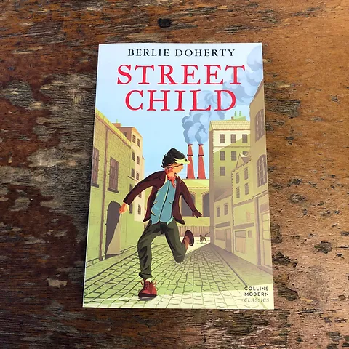

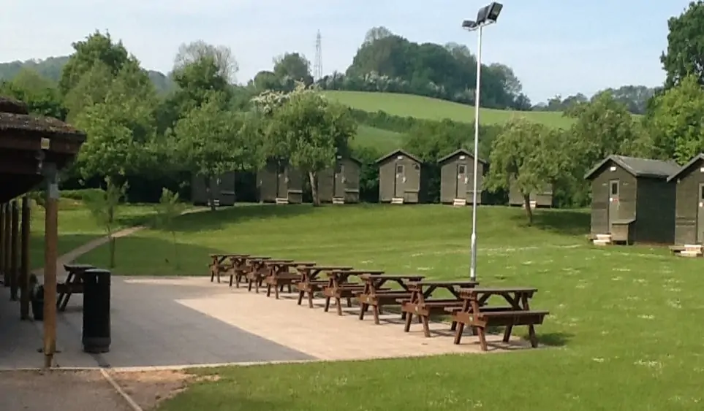
What to expect in Year 5:
A nurturing and calm classroom
Exciting learning in a range of subjects
Culture, comfort and creativity
Enjoying ‘Book based English’ for interest and engagement and love of reading
Revision of the basics – handwriting and spelling and punctuation. X tables
Increased Independence- helps them to feel empowered
Academic Progress &
Home Learning
Healthy living
Increased independence.
‘Learning to learn’.
Asking questions.
Having a go.
Not being afraid to make mistakes.
Not giving up.

Slide 4
Lessons and school life:
Thought provoking and spiritually enriching Religious Studies; great books to read and study; Creative and stimulating English; Engaging Maths; Practical Science; Interesting Topic work; Fun History projects; Geography; Music; Art; Drama and Dance; Computing and E-safety; P.E and Gym, Swimming and Games; PHSEE and Languages.
Enriching experiences:
Kilve Court residential, outdoor learning. We also visit secondary schools in the Summer term.
Growth Mindset – The ‘I can do it’ attitude:
Year 5 is when children begin to develop independence, resilience and organisation, readying themselves for the challenges ahead.
They can use the strategies we have taught them to; learn spellings; spot and steal great vocabulary; use a dictionary or thesaurus to aid writing and reading; edit and re- work writing; check calculations; learn x tables or solve problems in maths, design and experiment in art and DT.
Concentration:
This year is about developing concentration and encouraging an inquiring minds so they can achieve their potential now and in the future.
Responsibities:
Children will be given increased responsibilities, such as having Reception-buddies.
Curiosity:
They are encouraged to be excited, curious learners, to learn new facts and acquire knowledge and ask questions. They are encouraged to express themselves articulately, artistically and creatively.
The 3 C’s Culture, creativity and comfort!
Organisation: Do they pack their bag ready for the next day? Do they do up their own shoe laces?
1. Reading book and record. Scheme book (if on scheme) plus own choice book. Has it been signed? (everyday) Discussion on the book is key – vocabulary, themes etc
2. Smart P.E uniform – please wear to school on a Tuesday and Wednesday
3. Home learning (set on a Friday and submitted by Thursday)
4. Pencil case (optional)

Slide 5


Well-being
This year we are encouraging children to have an attitude of gratitude; to count their blessing and appreciate all they have and who they are.
Mental, emotional and physical well being
Exercise and fresh air and nature
Reading for fun and interest
Communication - Time to talk/show and tell/
Healthy diet
Early to bed, early to rise….
Water bottles for the brain!
Snack time – healthy and nutritious – low GI and low sugar!

Slide 6
Home Learning and how you can help
Home Learning is given out on a Thursday and is due in the Thursday and there is often a spelling and mental maths/tables test on the Thursday or Friday. Please support children to complete homework so they are prepared for the tests. Please submit evidence of this learning to google classrooms or send in a paper copy.
Spellings to learn - tested on Thursday (either from the Y5/6 list or Y3/4 revision list, revision of high frequency words or ones following a spelling rule that has been taught) Y5/6 Spelling are in the Reading record
See help sheet on learning spellings and websites for practice below.
You can also help by checking the spellings and sentences make sense, are correctly punctuated and have joined neat handwriting.
http://www.bbc.co.uk/education/subjects/zv48q6f
Brilliant BBC resources for all subjects including excellent and fun spelling games
Reading aloud to an adults 2 x per week and discussing the book .
Reading independently at least twice. Please make a note of this in the reading record once a week.
Some weeks, we will give a formal reading comprehension to complete.
Professor Assessor task or Times tables/mental maths practice.
Valuable practise can be given in daily life at home – money- decimals, weighing – converting measures, fraction – sharing food, mental calculations – playing card games and monopoly!
See https://nrich.maths.org/ and for a great resource – for children and parents.
https://www.theschoolrun.com/year-5/year-5-maths
https://www.topmarks.co.uk/maths-games/7-11-years/ a great site for learning tables and all maths and www.mathletics
Enrichment
Project work
BBC Dance mat typing practice.
http://www.bbc.co.uk/education/subjects/zv48q6f
Brilliant BBC resources for all subjects
Help with writing can be given by encouraging children to write stories, create projects, write a diary in the holiday etc
Science website https://www.stem.org.uk/primary-science requires a log in but is free
Art websites https://www.nationalgallery.org.uk/ general interest- woodlandsjunoir.co.uk
Developing opinions - discussing local, national and global events to help form opinions on a range of topics. (http://www.bbc.co.uk/newsround/) www.nationalgallery.org www.britishmuseum www.classical100.org
Encourage creative learning – museums, after school clubs, arts, music, sports, libraries…etc.

Slide 7


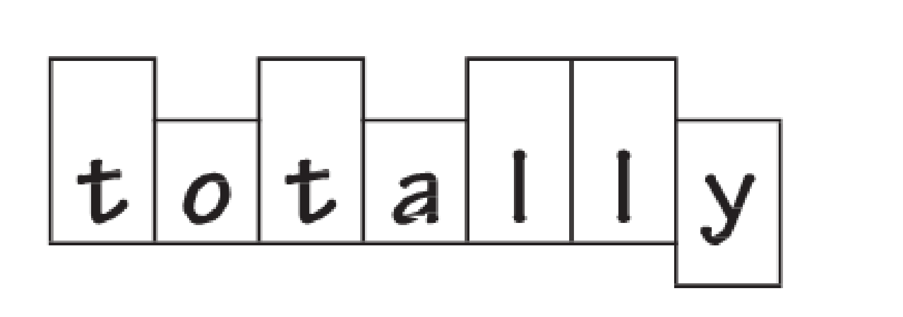
Learning Spelling
Read a lot! That helps spelling!
Here are some of the strategies you can use at home:
Mnemonics - Making up memorable ‘silly sentences’ for each letter
Saying the word in a funny way – for example, pronouncing the ‘silent’ letters in a word
Pyramid writing
Speed spell – write it in joined handwriting 10 times
Look say cover write check
Chunck the word Fl-ight/ em-pow-er/il-leg-al then write out 3 times each
Using colours to segment the word.
Illustrating the word or drawing around it to help cement the ‘picture’ of it.

Slide 8

Love Reading
Loving reading is so important, whether it is a story book, graphic novel or encyclopedia.
Read, Read, Read. Read aloud for fluency and expression.
Then these targets are fun!
I can read most words fluently and with appropriate expression, tone and intonation.
I can work out new words using my knowledge of phonics, prefixes and suffixes. I can use a dictionary and thesaurus.
I can understand what I’ve read, summarise, explain and discuss it.
I can give my opinion about a book and justify it.
I can retrieve, record and present information from non-fiction.
Keeping it going!
As you all know, reading to a child and talking about the book fosters a love of reading and is a special time where opportunities for questions about the world and growing up may arise and can be discussed with you in a reassuring way. Here are things you can do:
Listen to your child read aloud. Help fluency, expression, pace and awareness of punctuation (intonation). Try ‘tandem reading’ to get them over ‘the humps’ and keep the pace and sense going.
Read together and talk about the story, enjoy new words or information. Keep it chatty. Express your opinion too. Make observations and comments to show how to do this. Just like a book club.
Asking questions such as;
What’s your opinion of the book so far?
What genre is it? What atmosphere does it have? How does the author achieve that mood/feel?
Can you summarise the plot for me?
Who is your favourite character and why?
Why did that character do that?
How do you feel about a character?
How do you think the story might end?
Are there any new words you need my help with or we need to look up in the dictionary?

Slide 9
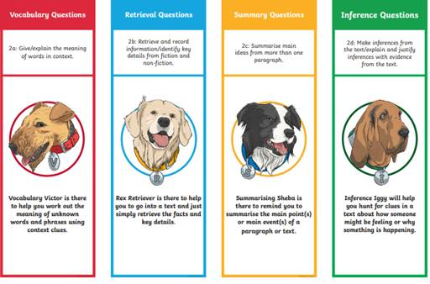
Reading in Year 5 – use these to help at home

Slide 10
Writing
Creative, purposeful and fun!
Read it back, check and edit. Use a yellow dictionary or dictionary/thesaurus
Composition and structure – does it make sense? Use paragraphs to organise writing. Vary the sentence structure.
Punctuate accurately, including speech marks and apostrophes.
Show some stylistic devices, such as metaphors, similes and alliteration.
Use a wide, varied and appropriate vocabulary.
Write in a style appropriate to audience.
Plan, edit and evaluate writing.
Understand and apply spelling rules
Join handwriting neatly

Slide 11

Maths
We follow the NCETM and White Rose small steps programmes.
A key focus in Year 5 is:
Practise the basics – play lots of dice games at home!
Learn your times tables the best way for your child – Times tables Rock Stars app if they like singing or professor assessor. Draw attention to the inverse of multiplication which is division.
Draw attention to maths in real life. Measuring opportunities – money counting, measuring in centimetres and metres. Spot decimals in money at the petrol pumps, the SATNAV - watch in the metres and KM
Learning to solve problems logically: using trial and error and working systematically.
Children are taught to calculate + - / x mentally – using a variety of mental strategies.
Children learn and refine the most efficient column methods for + - x and they learn to divide using the bus stop/ short method for division
Number and place value to a million including decimals and fractions 1-10
Calculations
Fractions, decimals and percentages
Measurement
Geometry: properties of shape/position and direction
Statistics
Mastery
There is a drive towards mastery of maths, which means that children should develop a deeper understanding of each concept and be able to apply their knowledge to solve problems before moving on.
For example, once there is an understanding of numbers and place value to a million, apply this knowledge to statistics.
e.g. interpret population data accurately
e.g. Once understanding column addition, can they estimate an answer and use rounding to check the answer? Or solve a word problem.
Or can they use subtraction to check an addition s

Slide 12
How to help! From the school run website -Strategy 1: Anyone can crack maths
‘People used to think that only some children have the ability to be good at maths now we know that is being disproved.
Strategy 2: Mistakes are good
When children think they’re going to fail at something, they usually don’t try. But recent research shows that the human brain actually grows most when you make a mistake in maths. Says Jo: ‘It’s ironic, because children feel terrible if they get something wrong in maths. But parents need to reassure kids that it’s not only good to make mistakes, but when you struggle at maths it means your brain’s developing.’
Strategy 3: Take a guess
Estimates aren’t right or wrong, so using estimation can be very confidence building – as well as a useful life skill to have. ‘A good question to ask is, “Do you think the answer you’ve just got is bigger or smaller than the proper answer?” as it encourages children to think about the values of the numbers in their maths problem,’ says Steve.
Strategy 4: Play around with numbers
In maths, the ability to play around with numbers is vital for mental arithmetic as well as real-life. It’s good to encourage children to play with numbers on paper, or with big counters in front of them. Having visual images is crucial as it reinforces the concepts in their heads. ‘There are some great simple games with dice,’ says Jo. ‘Try rolling five dice and challenging your child to make a number, 20 for example, out of the dice.’
Strategy 5: Use technology
If your child finds learning times tables almost impossible – or just really dull, a computer or smart phones can be a handy rote learning tool. Steve recommends a powerful technique called “self-voice echo”: ‘Type three facts from a times table onto the screen (for example, 5 x 8s are 40), then help your child record himself or herself reading it through in their own voice. Using headphones, they can listen to the audio over and over, while reading it aloud.’ This technique work best in short bursts of up to 10 minutes a day.
Strategy 6: Act like a maths fan (even if you’re not)
Many parents are scared of maths – particularly mums (more women than men have had bad experiences of the subject in the past). ‘Research shows that as soon as mothers comfort their daughters by saying they weren’t good at maths at school themselves, their daughter’s achievement goes down in that same term,’ says Jo. ‘So always try to greet maths homework with excitement – even if you have to use all your acting skills.’
Strategy 7: Find out more about primary maths yourself
Whether you're looking for details of what your child will learn in maths in primary school year by year, teachers' tricks to help with new mathematical concepts or everyday games to play to make maths fun, TheSchoolRun has loads of information and practical resources to help.

Slide 13
Achievement in Year 5
We would like to acknowledge all the achievements of all our children.
From achievements in spelling to achievements in sports, from cookery to curiosity, from karate to kindness.
We know the most important aspect of a child’s education is their interest and willingness to learn and find out new things. The rest then follows.
Formal academic achievement is measured by progress – where did my child begin the year and where are they now? Teachers are working hard on our recovery package of revision for the children. Take a look at the objectives.
Assessments will take place each term which, alongside day-to-day observations, will help recognise the arising needs of your children.

Slide 14
Assessment and Recording
We use a variety of summative and formative assessments to ensure every
child makes progress along their personal learning journey.
Within the Stage that the pupils are working on we assess whether pupils are
Working Below Expectations,
Working towards expectations,
Meeting Expectations,
Exceeding Expectations
ATTAINMENT – It is not expected that pupils will be Meeting Expectations until summer term, however, we will be able to report to you during the year whether or not your child is on track to meet expectations.
PROGRESS – This looks at each individual’s starting points.

