Slide 1

RECEPTION INDUCTION 2024/25
SAINT PATRICK’S CATHOLIC
PRIMARY SCHOOL
“Parents provide the seed, the school creates the tree. Saint Patrick’s do this very well; however, they do this with blossoms on!”
(Parent of children at St. Patrick’s)
“Parents, including those new to the school, appreciate the support and commitment leaders provide. One parent said, The school is a wonderful, happy environment and my children are thriving.”
(Ofsted 2022)
“Pupils are proud to attend St Patrick’s Catholic Primary School.”
(Ofsted 2022)
“An exceptional Catholic Community where ‘All Are Welcome’” (Denominational Inspection - July 2018)
Notes:
Jennie

Slide 2
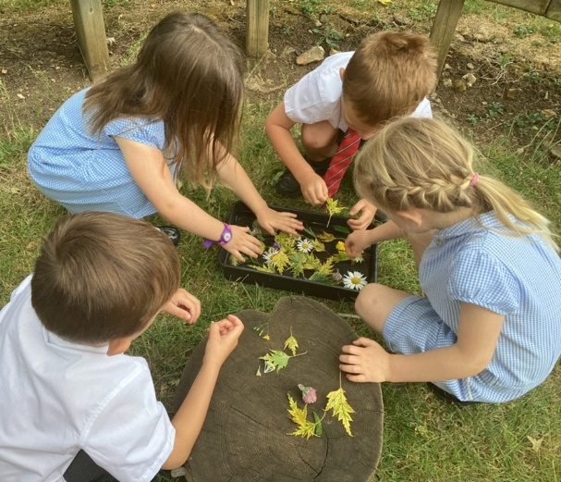
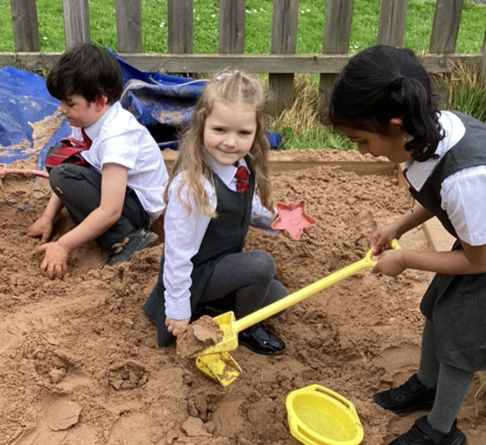
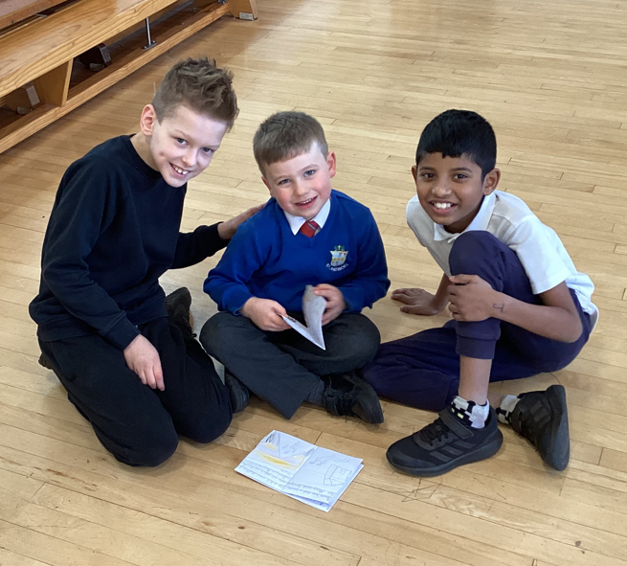
A Catholic Christian Community
Our Mission
To develop each individual child’s talents and potential in a caring Catholic community inspired by the teachings of Jesus Christ.
To Live, Love and Learn Like Jesus
Notes:
Jennie

Slide 3

Home School Partnership Agreement
The Home School Agreement is a contract which lasts for the next seven years.
It is a commitment between parents and the school to ensure that we forge a dynamic partnership in educating all of our pupils.
What does it look like in everyday terms?
Notes:
Jennie

Slide 4


Pastoral Support
AN INCLUSIVE…FAMILY…COMMUNITY
SCHOOL / PARISHES / COMMUNITY / HOME
Education of the whole child as a team
Communication - duty of care
Pastoral Care for your child
Our school is a DYNAMIC LIVING ORGANISM –
always growing, developing and seeking to better itself…
As a result, Saint Patrick’s seeks the active involvement, support and opinions of the members of its community.
“The school community has its foundations in the values of the Catholic faith. The school’s motto, ‘Live, Love and Learn Like Jesus,’ guides pupils every day.” OFSTED 2022
Notes:
Jennie

Slide 5
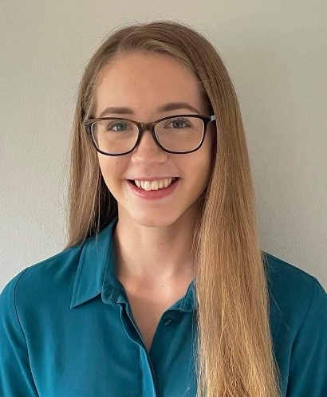
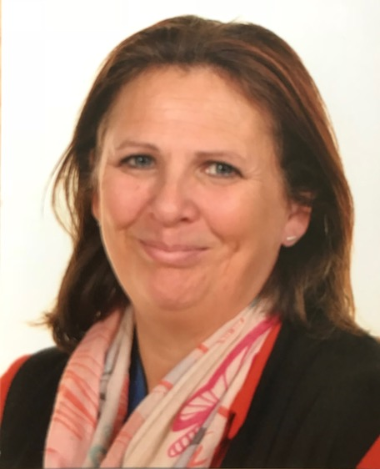
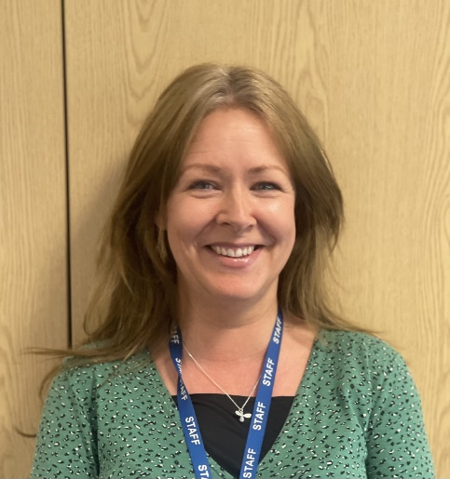
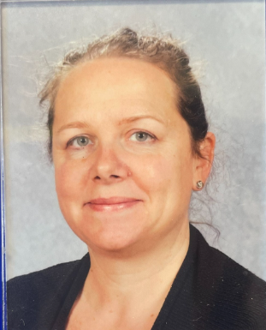
Current Early Years Team
Miss A Harding
Class Teacher
Mrs A Fudge
Teaching Assistant
Mrs R Hogg
Teaching Assistant
Mrs H Redpath
Teaching Assistant
Notes:
Ariana

Slide 6
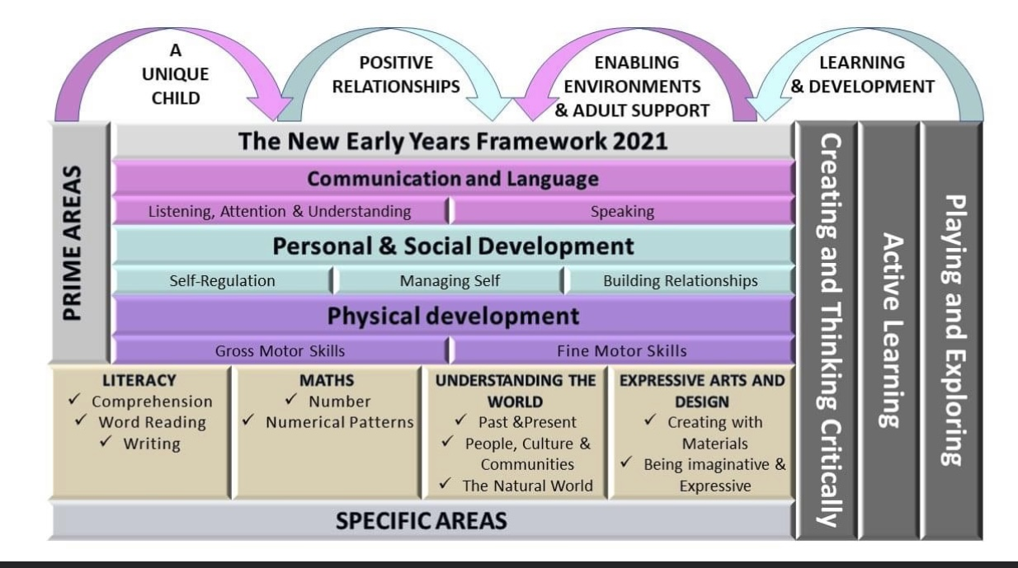
The Early Years Framework
The Early Years framework is designed for children aged 0 – 5. This is the last stage in the Framework before Year 1 begins. Why did the framework change in 2021? The changes to the EYFS statutory framework were made to: 1) improve outcomes at age 5, particularly in early language and vocabulary. 2) Reduce workload such as unnecessary paperwork, so we can spend more time with the children in our care.
This first year at school prepares children for the start of the National Curriculum.
The EYFS curriculum has a particular focus on the importance of developing and strengthening Communication and Language, Physical Development and Personal and Social Development.
If you would like more information about the EYFS Framework, please visit the Gov.uk website.
Notes:
Ariana

Slide 7
The Early Years Principles
Within the EYFS Framework, there are four main principles which guide all settings.
They are:
Every child is a unique child, who is constantly learning and can learn to be resilient, capable, confident and self-assured;
Children learn to be strong and independent through positive relationships;
Children learn and develop well in enabling environments with teaching and support from adults, who respond to their individual interests and needs and help them to build their learning over time. Children benefit from a strong partnership between practitioners and parents and/or carers;
Children develop and learn in different ways and at different rates. The framework covers the education and care of all children in Early Years provision, including children with Special Educational Needs and Disabilities (SEND) .
Notes:
Ariana

Slide 8
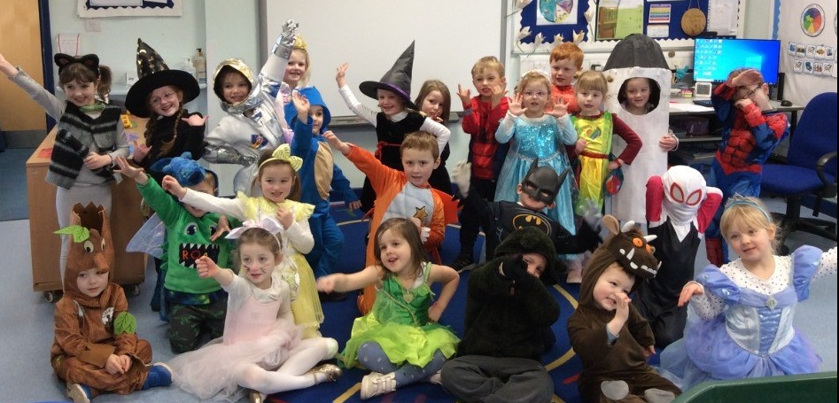
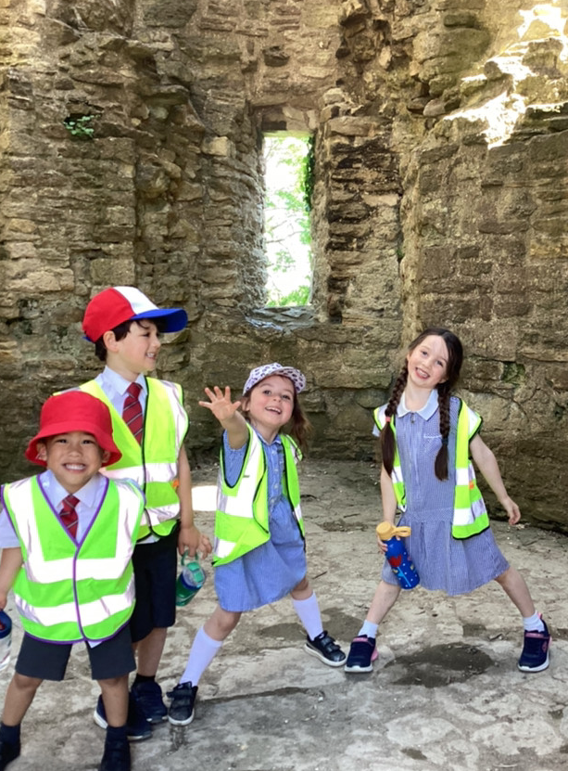
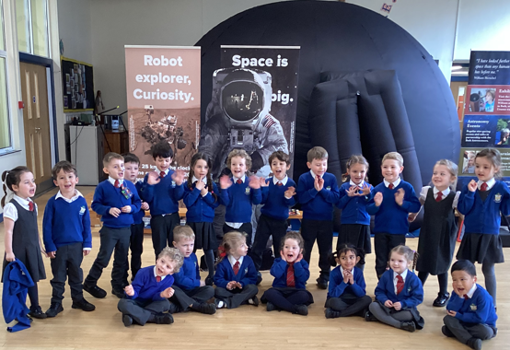
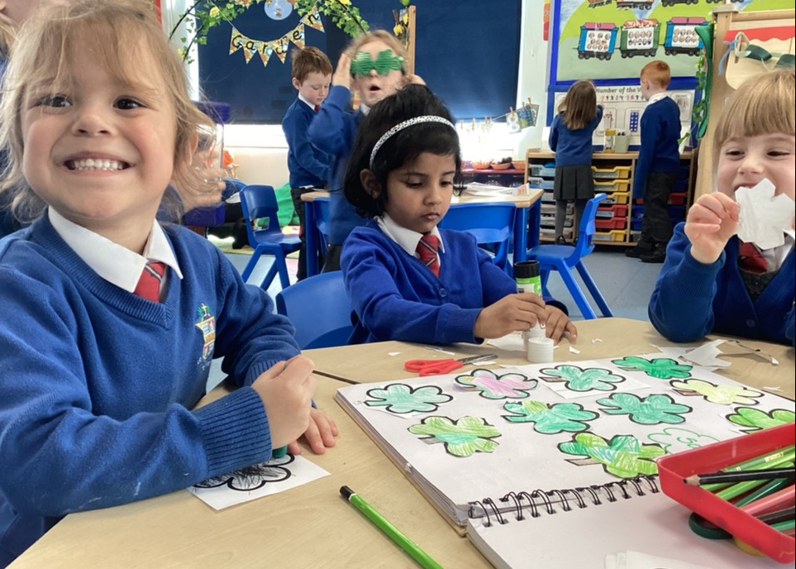
Curriculum Enrichments at our School
Saint Patrick’s themed day
PE enrichment days
Charity work –collected food for the local food bank
Saint Patrick’s Art Exhibition
Boccia Day
STEM WEEK – working with Colchester Zoo
World Book Day
Career’s Week
School trips – castle, theatre, Aerospace Bristol…
“The curriculum includes memorable experiences such as encounters with visitors to the school and trips.” OFSTED 2022
Notes:
Jennie

Slide 9
Induction Weeks
Your child’s induction…
Induction Weeks:
Week 1: Wednesday 4th September to Friday 6th September - half days (8.40am -12:00)
Week 2: Monday 9th to Friday 13th September – half days including lunch (8.40am -1.15pm)
Week 3: Monday 16th September onwards – full days at school (8.40am – 3:15pm)
Notes:
Ariana

Slide 10
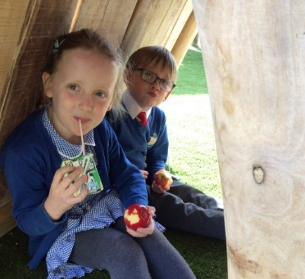
Lunch times –
UFSM / FSM explained!
ALL children in KS1 are entitled to UNIVERSAL FREE SCHOOL MEALS
Please fill out the form in the welcome pack if you think your child is eligible for free school meals (in addition to UFSM). ‘PUPIL PREMIUM’
Children having a school dinner will have a choice of three meals. Parents need to go on the school meals website to book school dinners.
Our new children sit together as a class at lunch. Our supervisors keep a special watch on all the new children to check that they are managing to eat their lunch.
Please ensure that you provide a lunch which your child will like to eat as we encourage everyone to eat as much of their lunch as possible.
The Reception children quickly learn the routines of lunch time at Saint Patrick’s.
Notes:
Jennie

Slide 11
Essential Information
Please label EVERYTHING your child brings to school including PE Uniform (white t-shirt / navy blue shorts / daps).
Please bring all money in an envelope with your child’s name and the purpose of the money.
Please make a point of speaking with a member of the Early Years Team about any specific medical condition your child may suffer with. This is in addition to the information which you have supplied on the form.
Please send your child to school with a book bag and a lunch box / book hot dinners when staying for lunch. Each child will have their own locker where belongings will be stored.
http://www.coolmilk.com children will be given free milk until the age of 5. If you would like to continue with milk after 5 then please register a few weeks before their 5th birthday.
You will have your induction pack, please return forms to the school office by the end of this term. This PowerPoint will be available on the school website under Parent Information – New Starters.
Notes:
Ariana

Slide 12
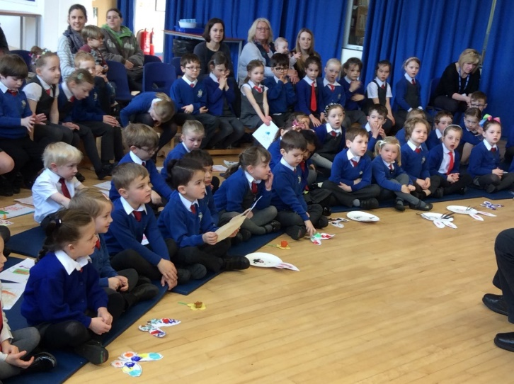
Developing Parent Partnerships at Saint Patrick’s
Provisional Meet and Greet sessions (during the 2 induction weeks)
Curriculum afternoon
Parents’ Evenings (October / March)
Annual Records of Achievement
Termly Assessment
Parent Information workshops
Learning Journals (Tapestry)
Informal conversation (morning/after school)
Notes:
Ariana

Slide 13

SAFEGUARDING
Keeping ALL our Children Safe
Register procedures
Absence
Medicine
Concerns
Use of Social Media
Confidentiality
Road Safety
Tolerance / Respect
Notes:
Jennie

Slide 14
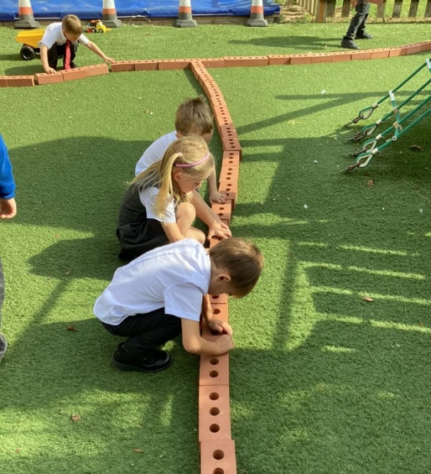
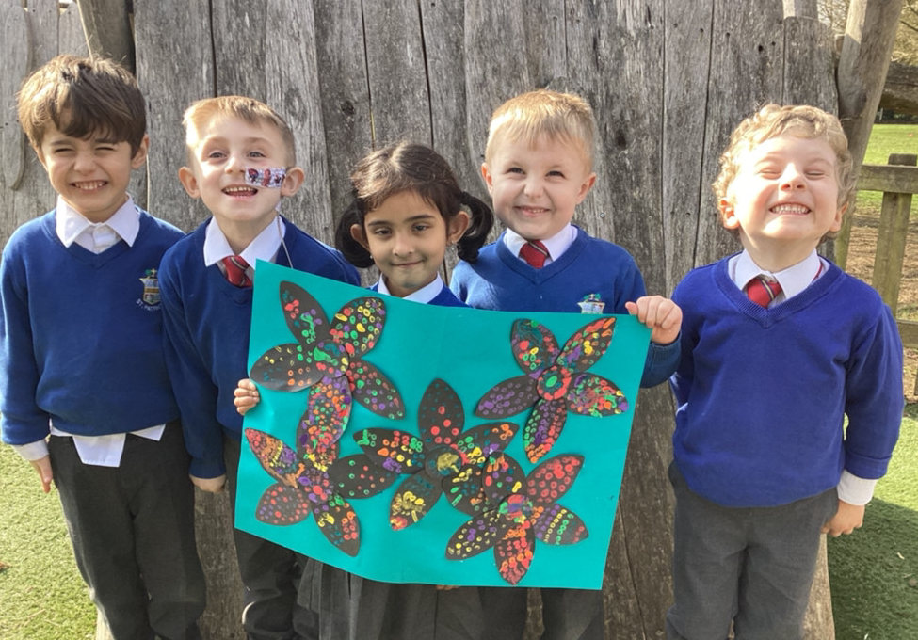
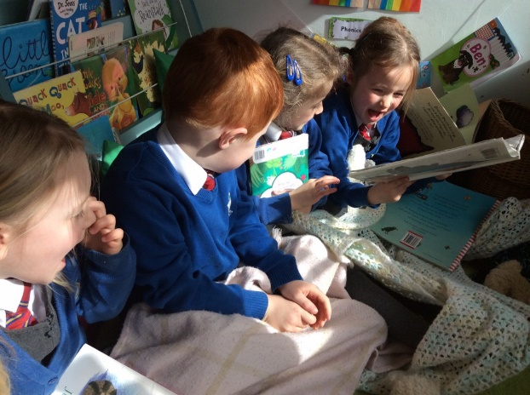
Preparing My Child for School
What can you do to help your child over the summer?
Enjoy books together and take trips to the library. Some great book are ‘Starting School’ by Janet Ahlberg, ‘I am too Absolutely Small for School’ by Lauren Child and ‘Harry and the Dinosaurs Go to School’ by Ian Whybrow and Adrian Reynolds.
Encourage your child to do as much for themselves as they can e.g. dress/undress independently, manage their toilet needs, using cutlery correctly, recognise their own name and begin to make their own choice.
Encourage lots of fine motor and gross motor activities.
Talk with your child about school, new and old friends and how they are feeling about starting school.
Notes:
Ariana

Slide 15
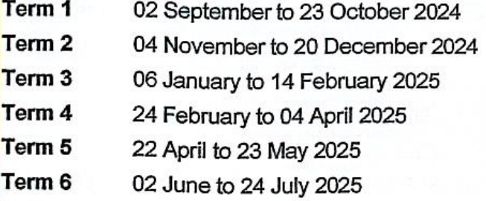
School Term Dates and Day Closures
This year, all primary schools will hold 5 day closures in addition to the holiday dates when the school members of staff are engaged in staff training activities.
The following term dates are for your information:
The first day of the academic year for your child will be –
Wednesday 4th September (until 12noon)
INSET DAYS FOR 2024-25
Monday 2nd September 2024
Tuesday 3rd September 2024
Monday 2nd June 2025
Tuesday 3rd June 2025
Wednesday 4th June 2025
Notes:
Jennie

Slide 16

On Reflection…
We are looking forward to a ‘super’ year ahead with you!
Please take a superhero pencil to start creating with, during the summer holiday.
Notes:
Jennie

