Slide 1

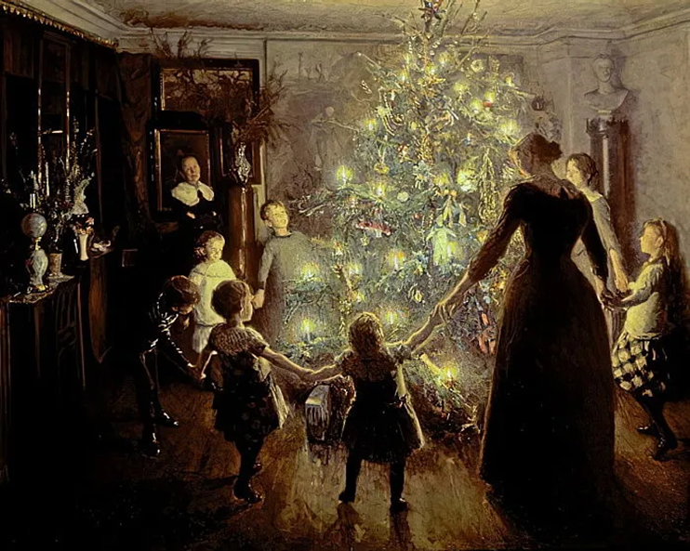
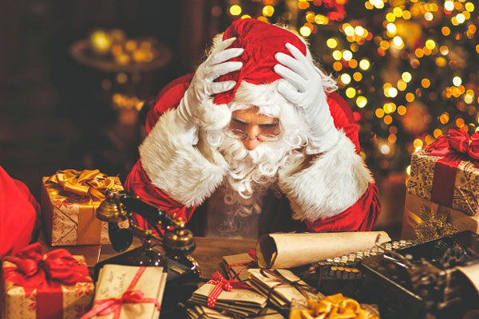
How to Survive Christmas
Best Christmas Movie Moments https://www.youtube.com/watch?v=XBJWo_91noA

Slide 2
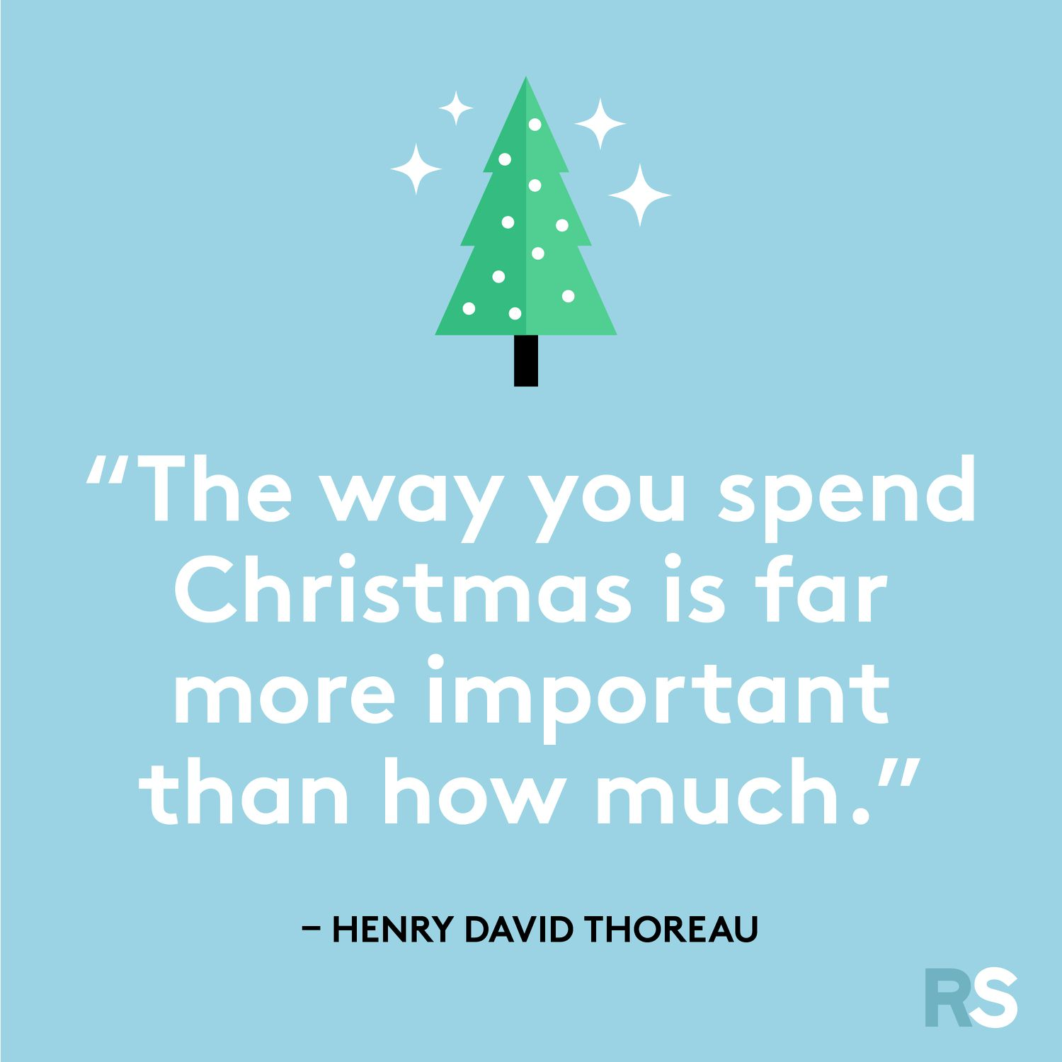

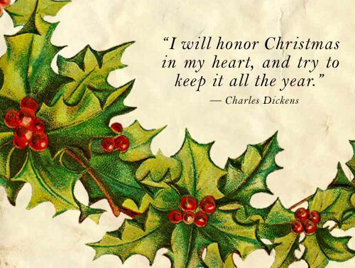

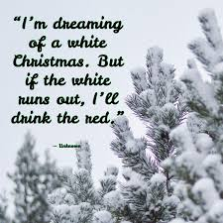
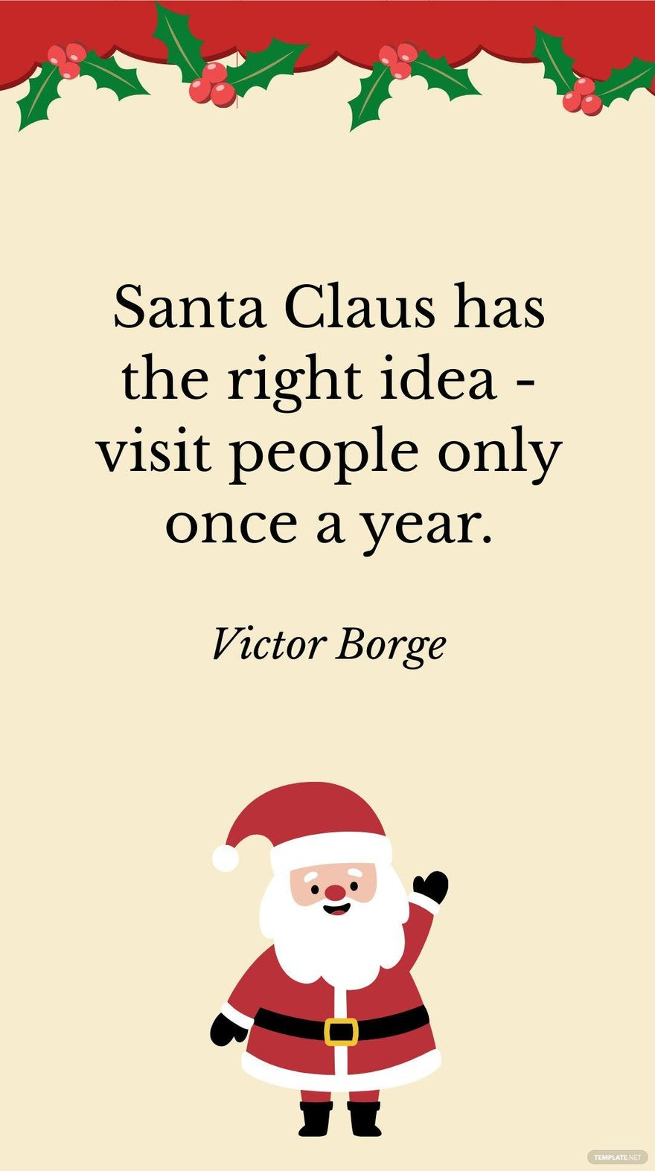
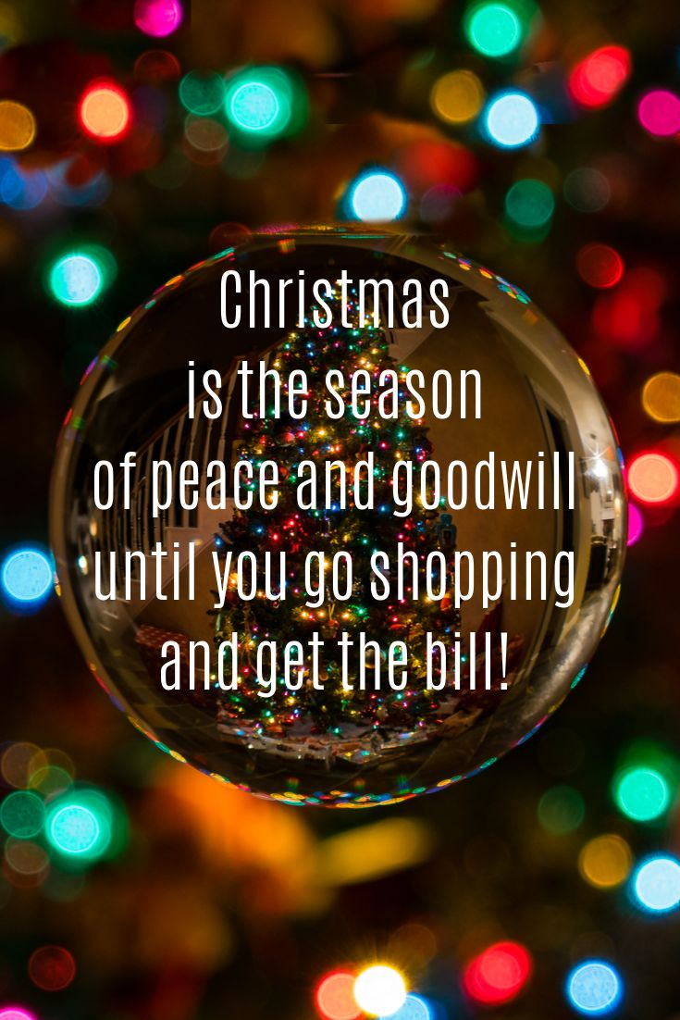
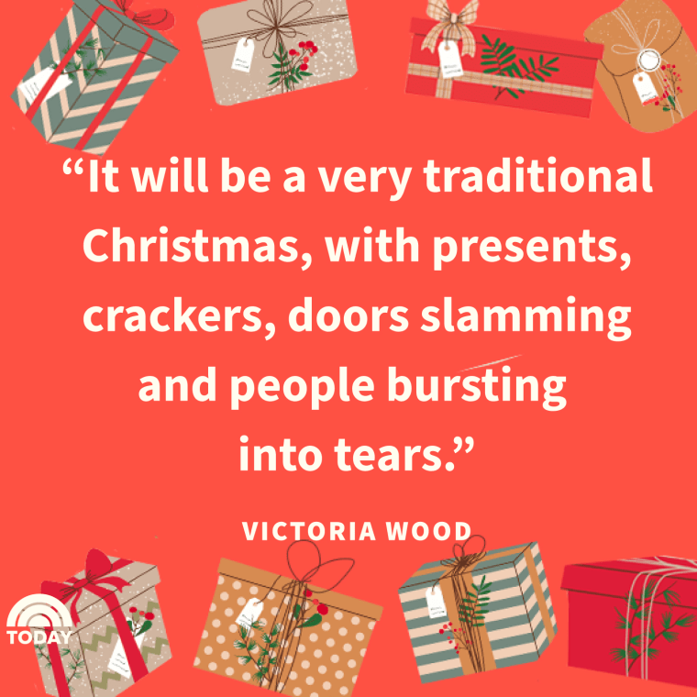
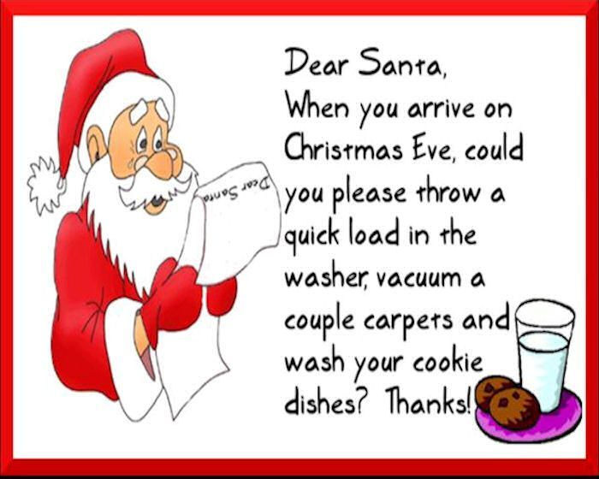

Slide 3
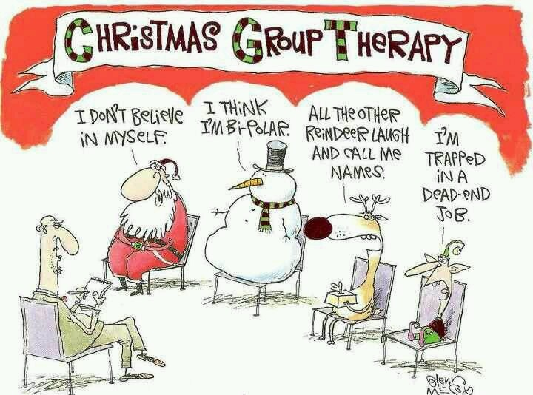

Slide 4












The most wonderful time of the year……

Slide 5
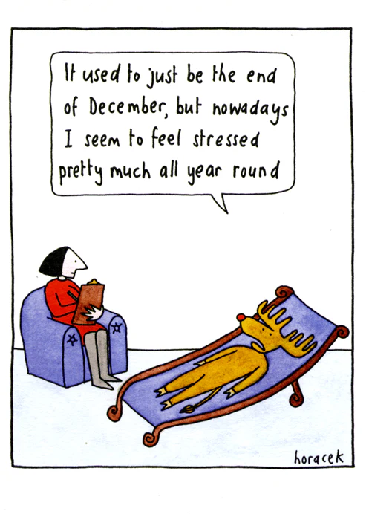
Does Christmas go on too long? How to cope…

Slide 6
Planning really helps, especially lists!
* Plan the 3 days – Christmas Eve, Christmas Day, Boxing Day
* Travel / Journeys and packing
* Shopping - food, gifts
* Meals needed
* Plan your downtime
* Talk your children through your plans

Slide 7
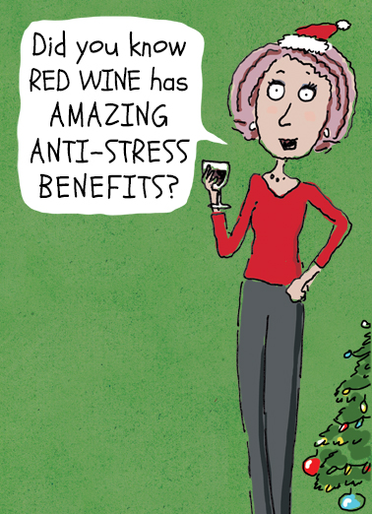

Slide 8
Let’s be realistic…
* It’s a holiday, but it still needs some structure to avoid too much stress!
* Children and Meal Times
* Don’t force children to make small talk
* Pick your battles
* Can you cope with the day(s) planned?
* Most arguments and disagreements come from unrealistic expectations!

Slide 9
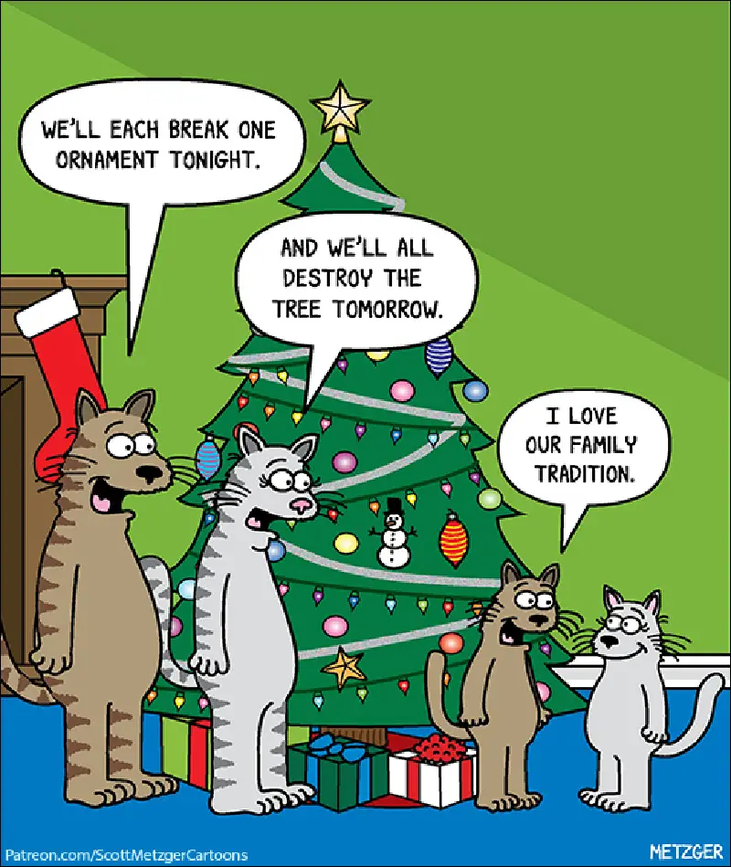

Slide 10
Can we have a back up plan?
* There is nothing wrong with
having an exit plan!
* Sometimes it is better
to admit a situation isn’t
working than battling on
* Talk to and agree a plan,
with those you are spending
the big days with
* If all goes wrong, have an
exit plan for you or your children
* Ignore the perfect
‘Instagram’ family photos
* Your children will remember
memories more than toys

Slide 11
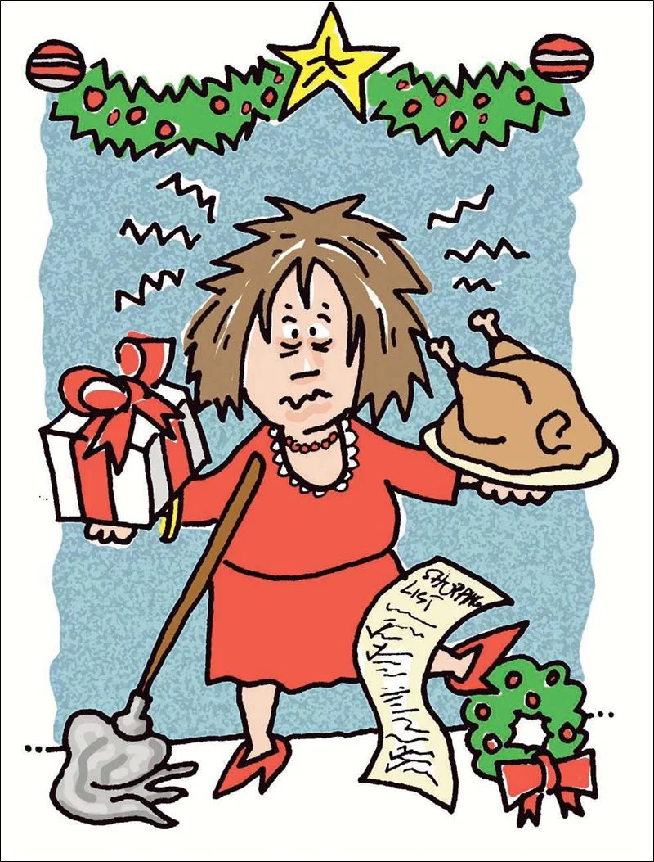

Slide 12
Don’t take it too seriously
* Remember it is only a few days and the shops shut on 1 day!
* Although it may feel difficult,
most families are only together
for a few days
* Your house doesn’t need
to be picture perfect, it’s a home!
* Diets change at Christmas
for us all
* Remember the importance of downtime for everyone, you included

Slide 13
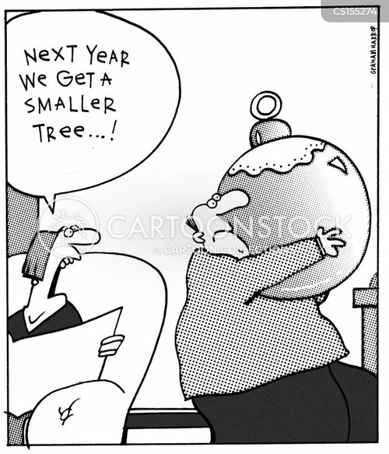

Slide 14
Have difficult conversations in advance
THIS IS THE ONE WE ALL WANT TO AVOID!
* Be honest with yourself and those closest to you, are you spending Christmas with those you WANT to be with our those you HAVE to be with?
* Are you going to be battling the technology, bed time, early moans?
* Start early when people start asking. Which things do you REALLY WANT to go to or NEED to go to?
* Do the people you will be with, understand your children and family?

Slide 15


Slide 16


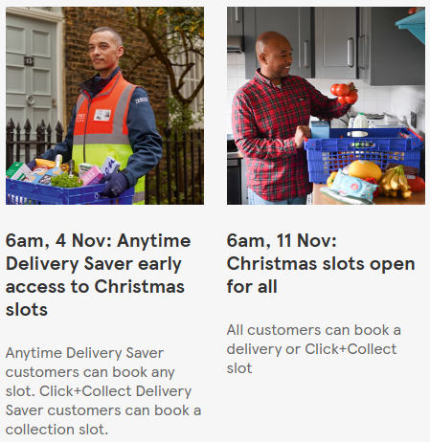
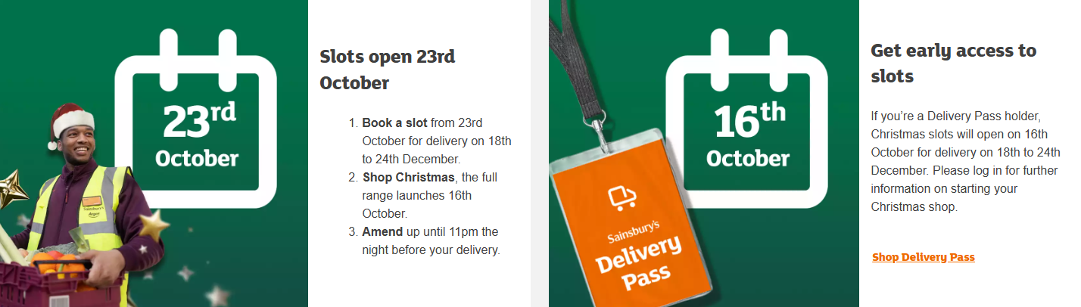
Let us try to help, lets start with food shopping!

Slide 17


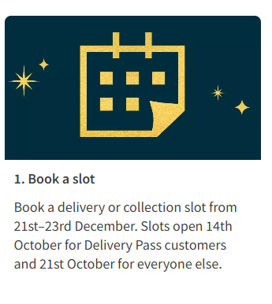
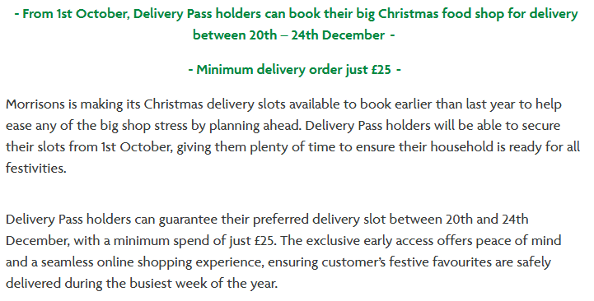

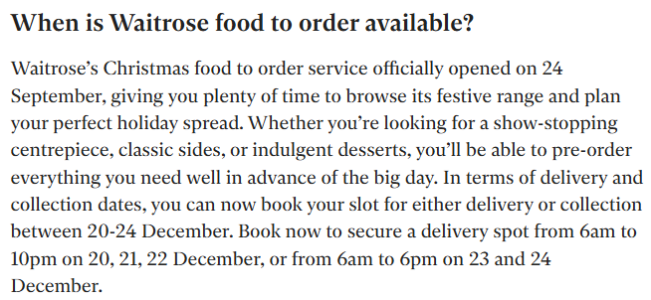

Slide 18
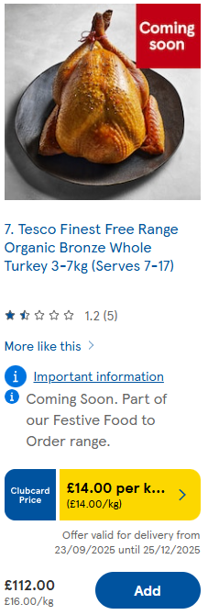
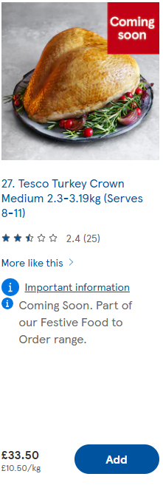
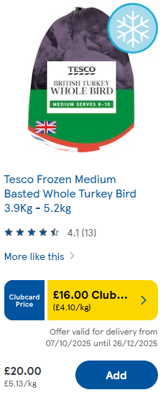
Do you need a Norfolk Bronze turkey…or even turkey?

Slide 19
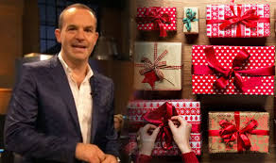
Listen to Martin Lewis…
* He found that products were 70% cheaper on Black Friday with 12% dipping lower in the pre-Christmas period and the remaining 18% were equal.
* Black Friday officially starts on Friday November 28th 2025, but many UK retailers begin their sales earlier, often starting in early to mid November. Some stores have already launched deals, and the sale period typically continues through Cyber Monday, which is December 1st 2025
* Mr Lewis urges people to be cautious around gift vouchers, citing two common pitfalls: expiry dates that quietly eat away at value, and the risk a voucher becomes worthless if a retailer collapses. He still prefers good old cash for maximum flexibility.

Slide 20




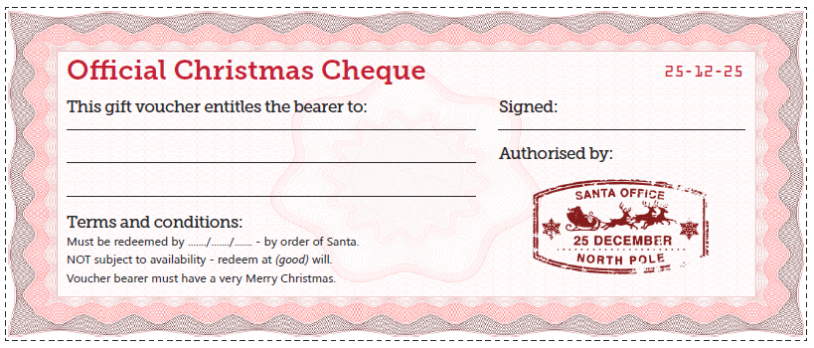
Other Ideas…
Before you buy any gift type into Google and click ‘shopping’ to get a price comparison across the shops and internet or PriceSpy https://pricespy.co.uk/
Put things in your online basket and leave them there, even if it’s only 15 mins!
Look for free photo print companies such as Snapfish or Free Prints, you between 45 and 50 free photographs printed, you usually have to pay £3.99 postage approx. These could then go in a frame of choice to make a lovely present under £10
Treasure Trails are pre planned treasure hunts all over the UK. The site tells you how many miles they are, some can be in a car, and they are fun for the family for £9.99! Gifts vouchers are also available
Family Secret Santa. Many of us do these at work, but could you introduce them for family members or friends visiting to keep costs down for all?
Christmas Cheques. These look lovely and would be free, but far more beneficial and meaningful. Could you gift a cheque to have a sleepover for a friends child, movie and popcorn night, baby sitting, chores in the house, dog walking or use your skills and talents e.g. gardening, baking etc.

Slide 21
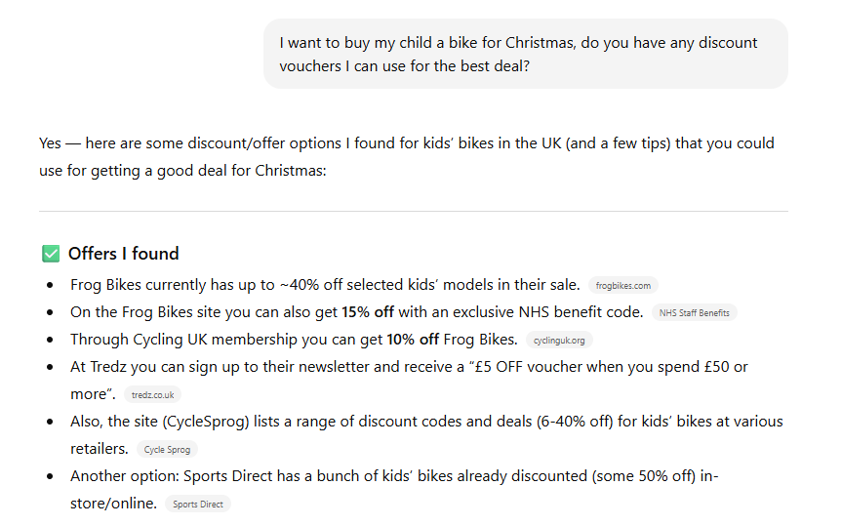
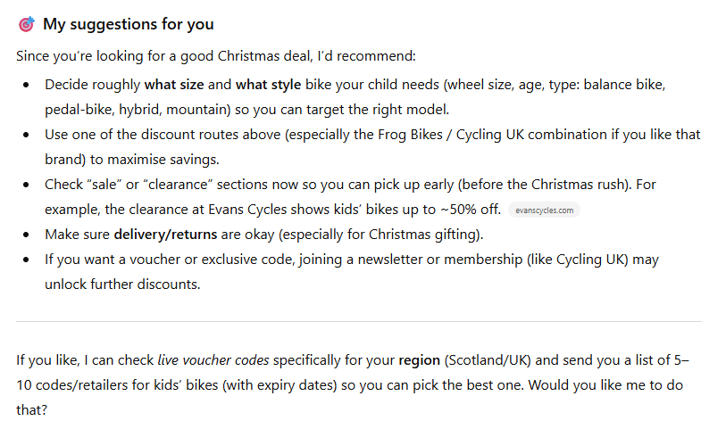
Chat GPT can help…

Slide 22
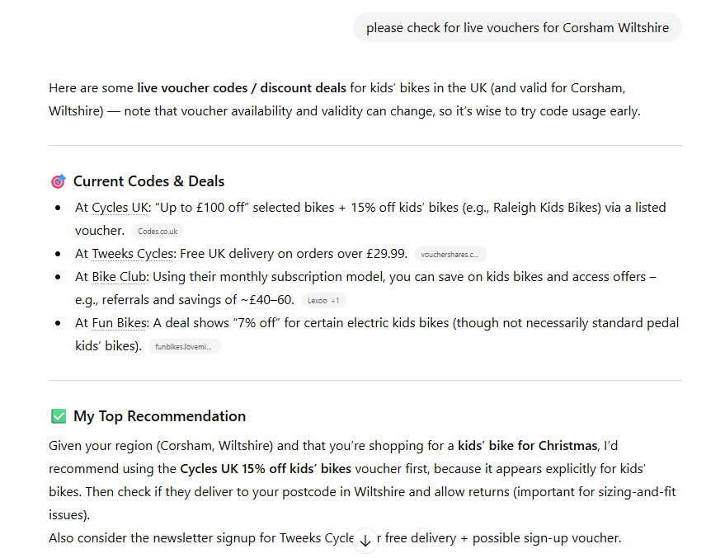

Slide 23
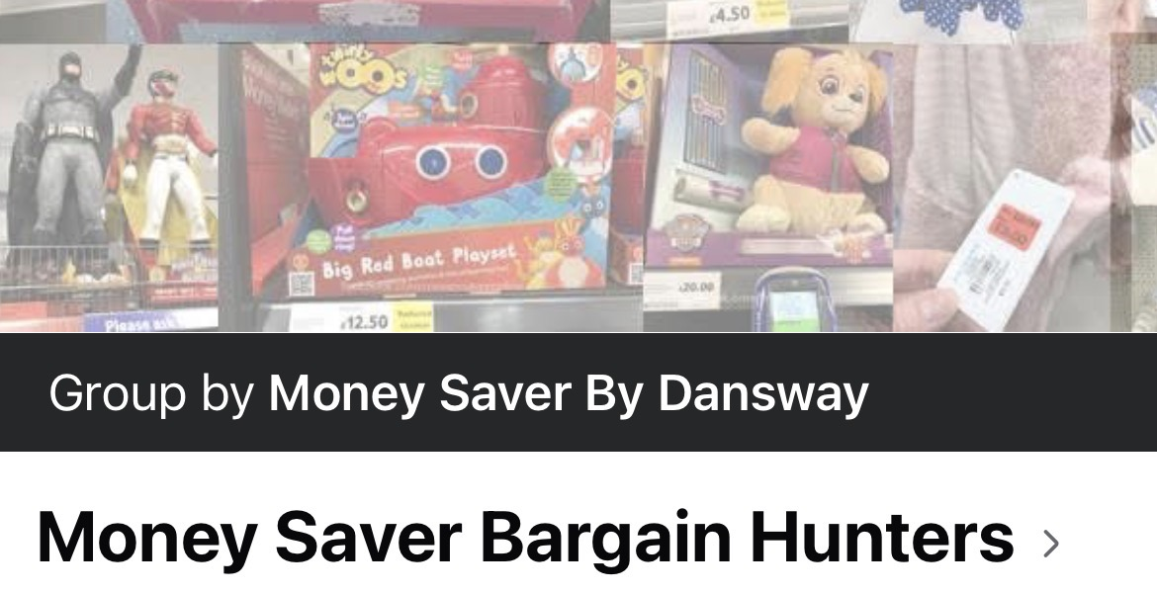



Here are some tips for finding offers for 2025:
Join ‘groups’ on social media:

Slide 24



Current offers available now…
12 kids' picture books for £10 (it's normally 10 for this price), or four adult fiction or non-fiction books for £7.50 (it's usually three for this price). Both offers are running until Thursday 20th November.
B&Q* launched its Black Friday sale online and in selected stores on Friday 31st October, and it'll last until Monday 1st December. Hyundai 3000w 3-in-1 leaf blower, vacuum, shredder HYBV3000E2* – £35.99 (was £44.99). Next cheapest, £44.99 at Amazon and Hyundai
Argos has discounted hundreds of items for Black Friday online and in stores across many departments including homeware, electricals, health and beauty.‎ The sale started on Friday 31st October and lasts until Tuesday 2nd December. Also spotted…a £5 off £50 code, but this was only accessible to those who download the Argos app and build a wish list.
Cookworks 9L dual air fryer – £50 (was £100). Not found elsewhere

Slide 25
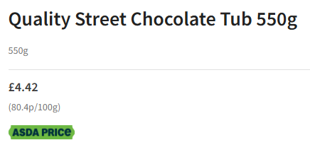
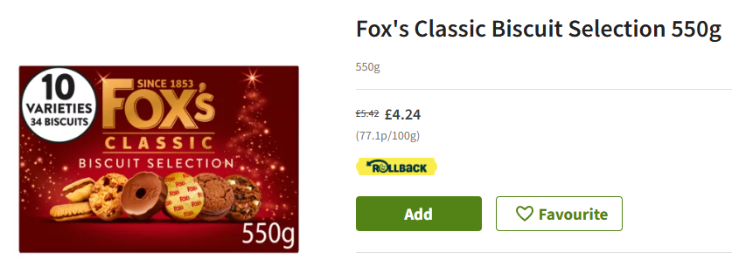
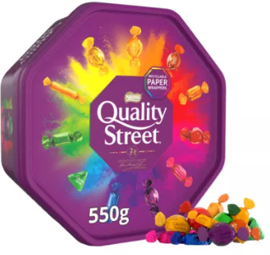
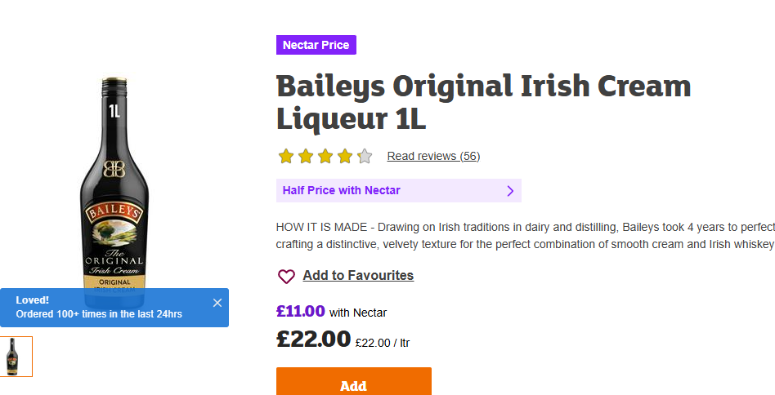
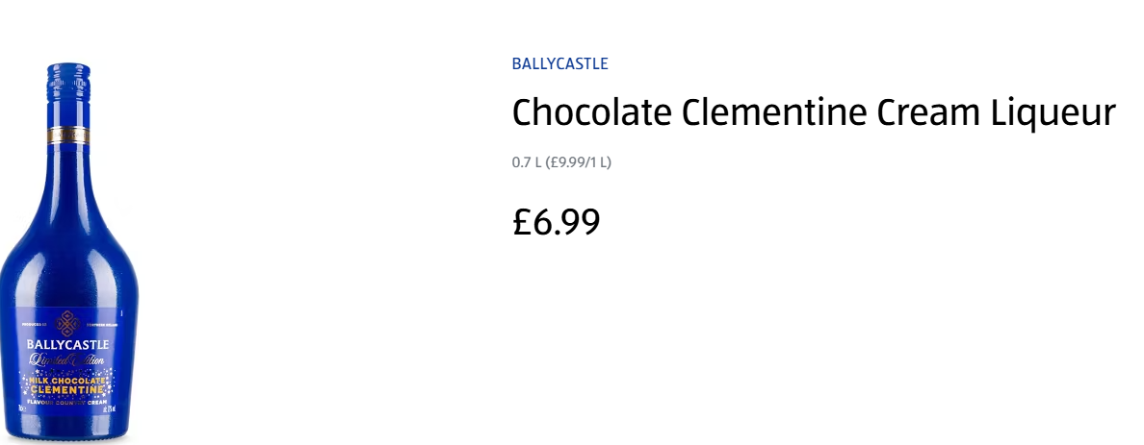
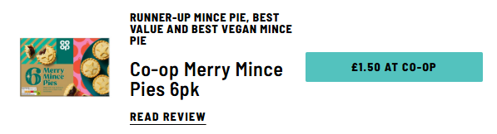
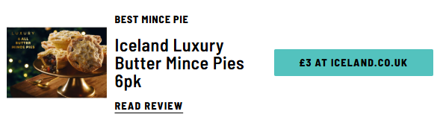
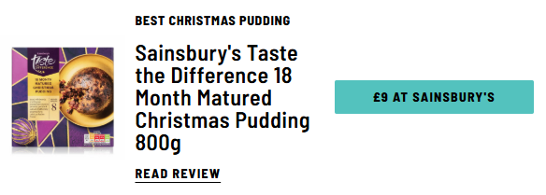
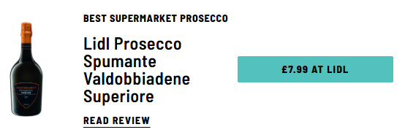

Slide 26




Predictions from Martin Lewis…
Predicted from Tuesday 18th November (up to 50% off), then from Friday 28th November (up to 60% off) till Monday 1st December.
12 days of deals & 30% off Amazon Resale predicted from Thursday
20th November till Monday 1st December. Its recent Prime sale had strong
deals on AirPods 4 (£105) and Lego sets, so look out for similar deals.
Up to 70% off, boosting to up to 75% off on Black Friday, predicted from Monday 24th November till Monday 1st December.
30% off 1,000+ full-price items predicted from Friday 21st November
(if signed up to its emails) or from Monday 24th November for all
till Sunday 30th November

Slide 27



Up to 40% off selected sets predicted from Friday 28th November
till Monday 1st December. Lego’s 2024 sale offered up to 40% off selected
sets for everyone and up to 20% off an exclusive selection of sets for
Lego Insiders (free to join), both online and in-store.
25% off when you spend £50 predicted from Tuesday 18th November
till Tuesday 2nd December.
Black Friday 'specials' including £5 off £50 or £10 off £100 spend predicted from Tuesday 18th November till Monday 1st December. Smyths offered a variety of toy deals for Black Friday last year both online and in-store, including buy-one-get-one-half-price on board games, 3for2 on Crayola, as well as price-matching consoles.

Slide 28


Look out for these retailers and special promotions they run!

