Slide 1
Year One Curriculum Afternoon
2024 – 2025

Slide 2

Welcome to the Year One Family

Slide 3
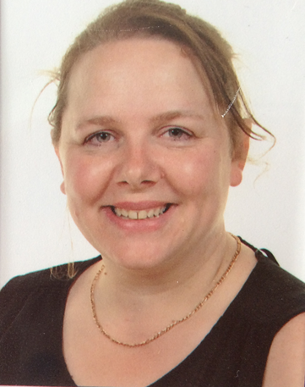
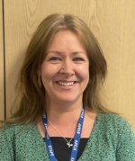
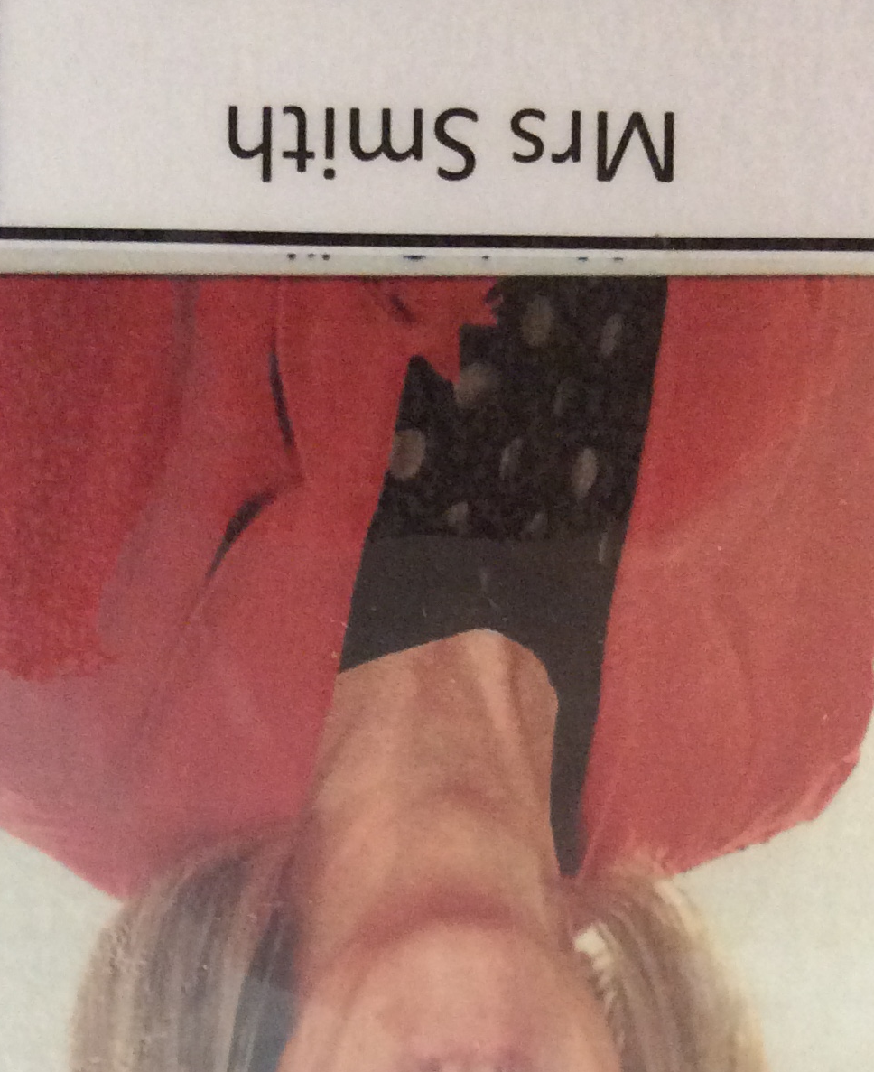
Our FABULOUS Year 1 team!
Mrs Smith
Class TA
Monday and
Wednesday
Mrs Redpath
Class TA
Tuesday
Mrs Hogg
Class TA
Thursday and Friday

Slide 4
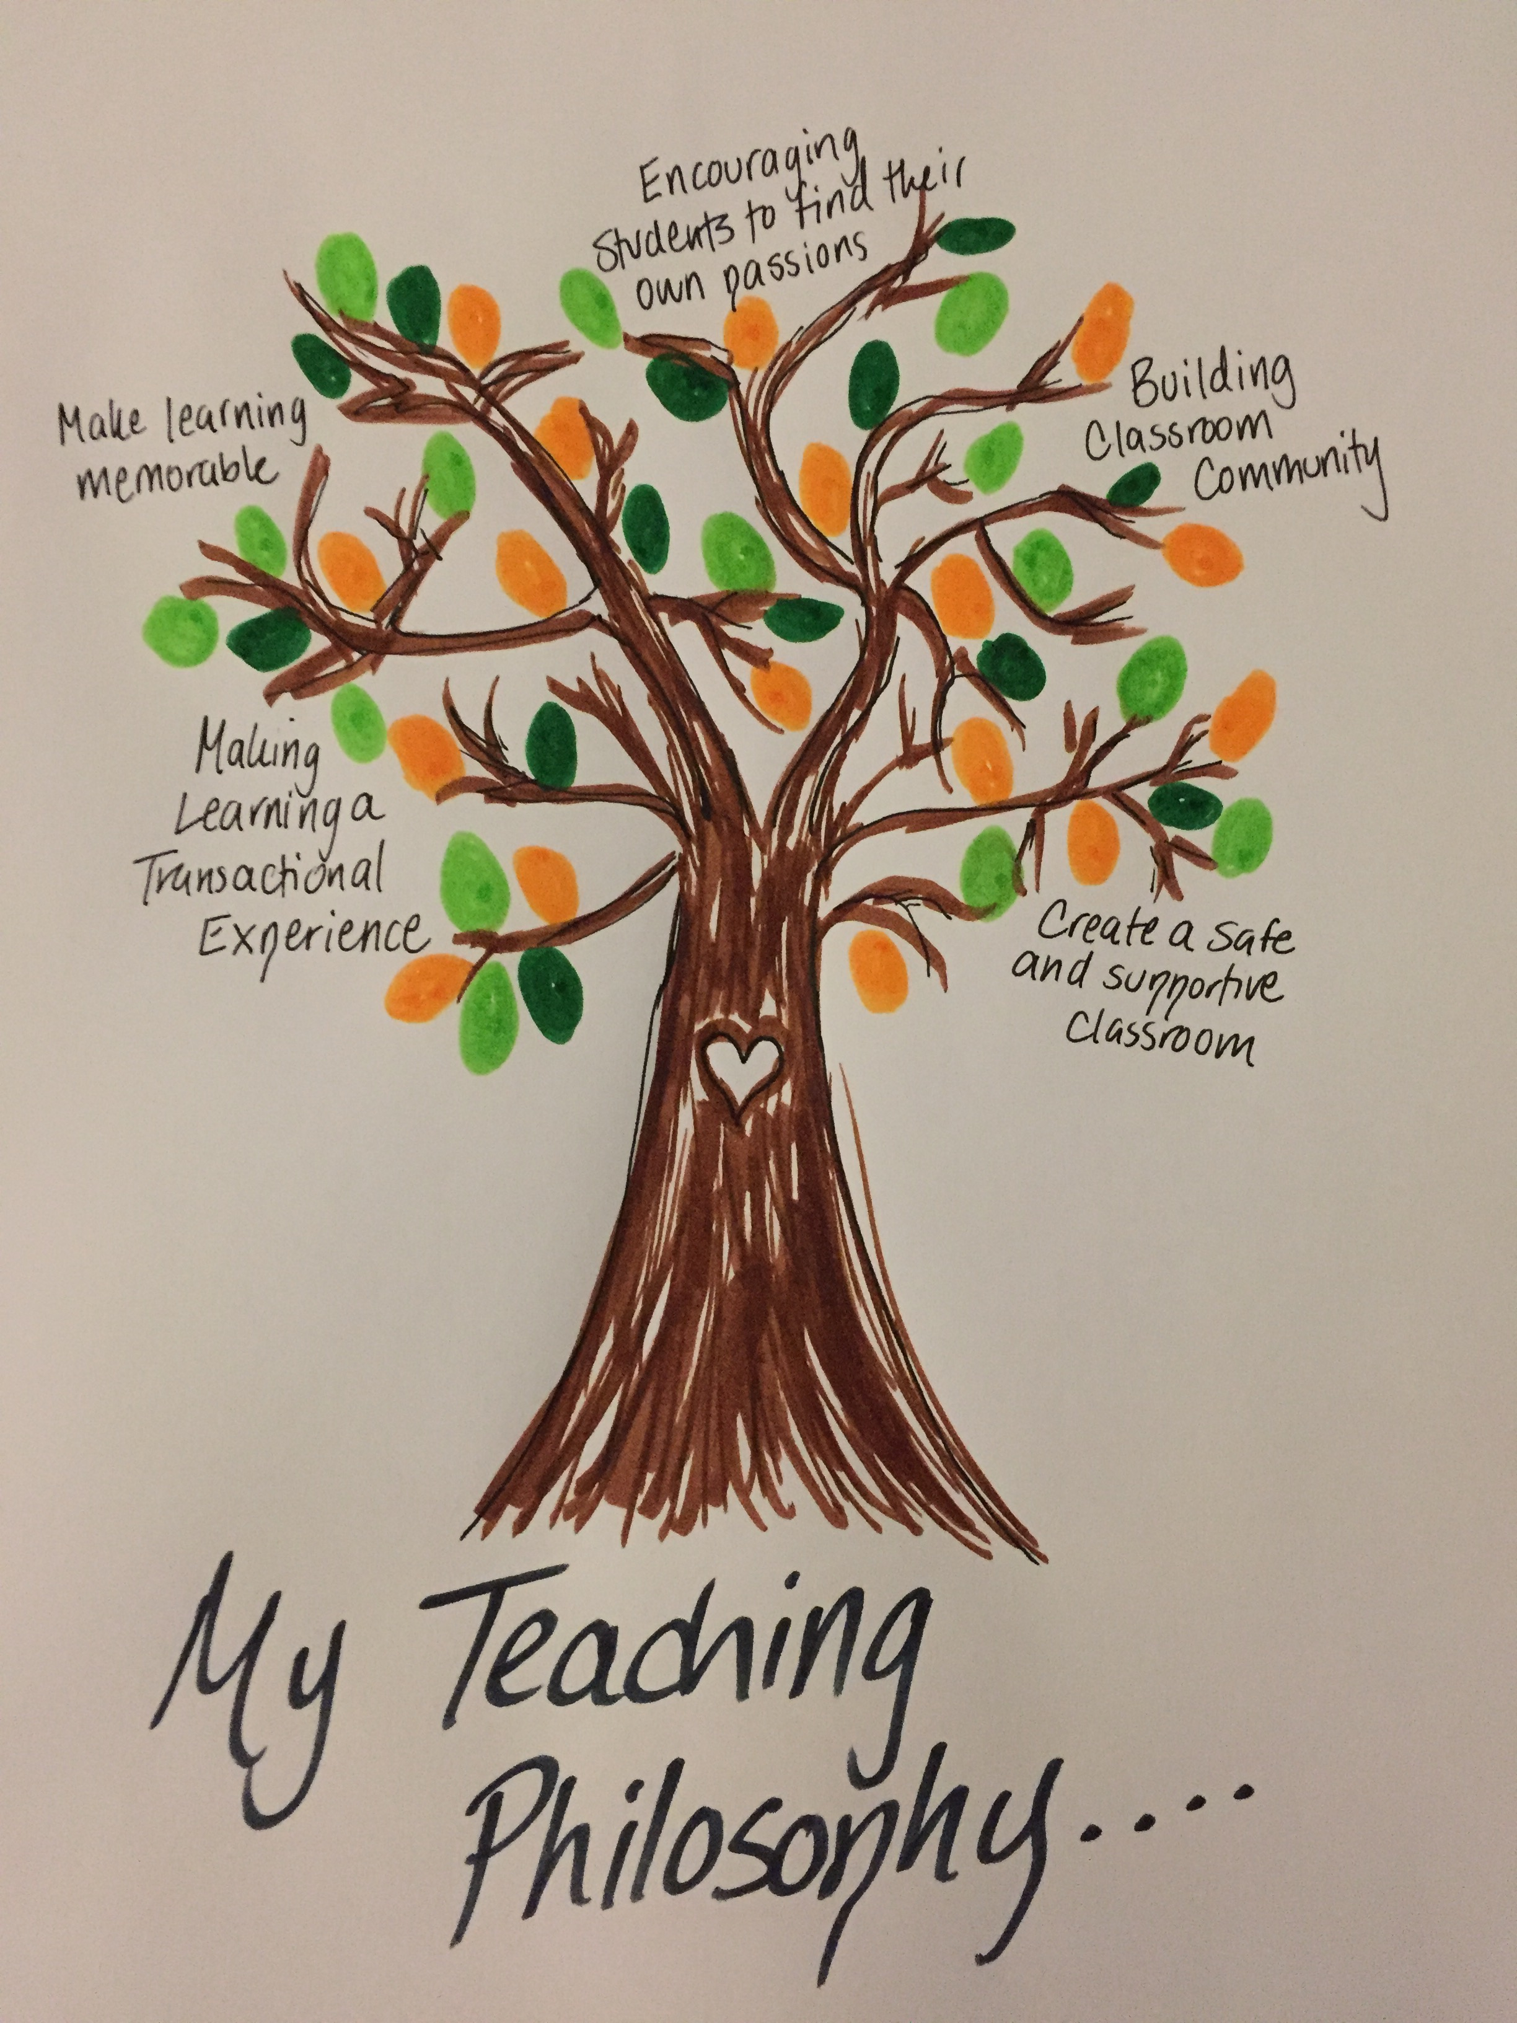

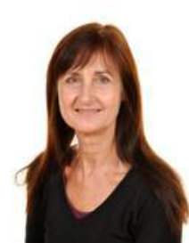
Meet the Team!
Year 1 class teachers… and our educational philosophy!!
Mrs Sykes
Monday, Tuesday and Wednesday
Mrs Cawtorne
Thursday and Friday

Slide 5
Classroom Environment and Routines
The children are sitting in small groups. We are encouraging them to develop friendships with a variety of children through varied table seats and opportunities to work with different children.
We continue to teach the children good hygiene routines (such as bin it, hand washing after sneezing, coughing into elbows etc).
PE uniform to be worn on Tuesday and Thursday. Full school uniform on Monday, Wednesday and Friday. Please see us if you have any questions.
Please remember water bottles and to label them.
Transition from EYFS into Year 1 means we are continuing with some small group work, as well as some whole class sessions. We will build on this throughout Year 1 ready for Year 2.

Slide 6
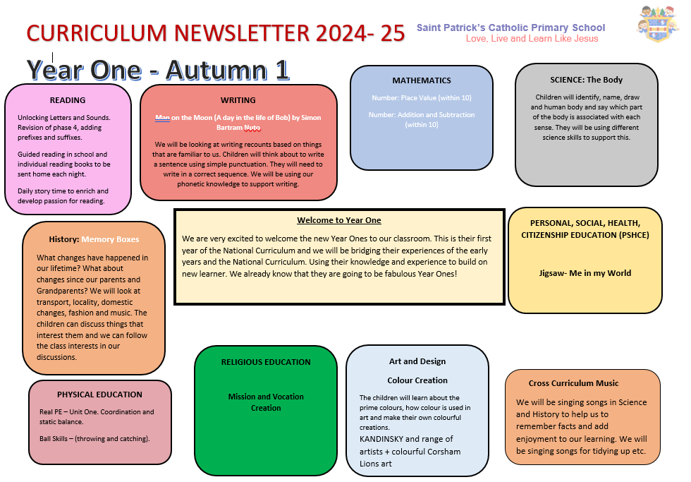

Slide 7

Personal Development
Behaviour expectations – we expect good listening (both when adults and children are talking), kindness in words and actions, politeness and trying our best.
The Regulation Station!
As a class we have been looking at different emotions and how we learn best. In our classroom we have a regulation station that the children can use to take some time to reflect and regulate their emotions. The children are building on the work they did with Miss Harding in recognising these emotions for themselves.
Live, Love and Learn Like Jesus
The children have spent time exploring our school mission and what this looks like in our classroom.
In Year One we are encouraging the children to see the good in each other.

Slide 8
Year One Curriculum
Year One is the first year of the national curriculum.
Each year the curriculum is planned in a way that will meet the needs of all pupils in our care.
We are moving from EYFS into Year 1 and finding the balance between the 2 curriculums.
Please see our class page for end of year expectations in Maths and English.
https://www.theschoolrun.com/year-1

Slide 9

Key Stage One: National Curriculum
This is your child’s first year in the national curriculum.
The core subjects this year are English, Maths, Science and RE.
There is a phonics test in the Summer term of Year One.
Phonics will continue throughout Key Stage One.
Children's starting points are used to inform planning.
The foundation subjects will be taught across the week, this term we are focusing on memory boxes, our bodies, colours in art. Please see curriculum newsletter for more information.

Slide 10
Assessment and recording at St. Patrick’s
Children will be teacher assessed against objectives from the National Curriculum.
Within school we are continually assessing against objectives for the end of each Stage using the terminology: Working Below Expectations; Working Towards Expectations; Meeting Expectations; Exceeding Expectations.
We have already started to record assessments in order to be able to measure progress throughout the year.
We continue to collect data and share this information with you at the end of Autumn, Spring and Summer.

Slide 11
ASSESSMENT
ATTAINMENT: It is not expected that children will be Meeting Expectations until the Summer term.
PROGRESS: Regardless of starting attainment and/or Stage, all children should move from one band to the next in a whole year.
At Parent’s Evenings, pupil progress against Stage Objectives will be discussed.
We value the starting point of each child and know that will vary.
Building foundations of knowledge, understanding and skill
Progress is individual
Each child learns and makes progress at different rates
Our aim is for children to be happy, secure and making progress.

Slide 12
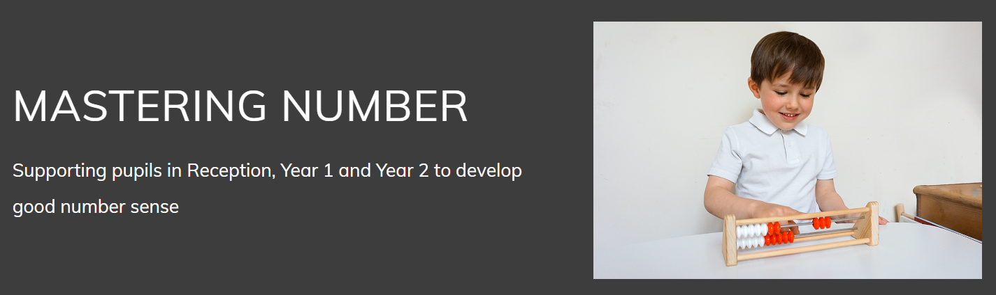
Saint Patrick’s Catholic Primary School are following the ‘Mastering Number Programme’ by NCTEM National Centre for Excellence in the teaching of Mathematics’
Our aim is to secure a firm foundation in the development of good number sense for all children from Reception through to Year 6. Lessons are designed with careful small steps, questions and tasks to ensure the learning is not superficial. A lot of time is spent on developing deep understanding of key ideas about number that are essential for all future learning. We encourage the children to’ think like a mathematician’ and ask them to explain how they have gone about solving a problem. We work with them to test, prove, explain, reflect and spot patterns. The aim over time is that all children will leave KS1 with fluency in calculation and a confidence and flexibility with number.
What can you do to support your child?
Maths is all around us. Count things around you. Count things you cannot touch, like lights (more difficult). Count in 1’s up to 20, 50,100, forwards and backwards. Count in 2’s from 2 (even numbers) or if that’s easy for your child try from 1,( odd numbers). Later in the year count in 10’s and 5’s, again forwards and backwards.
Play games where you have to count like snakes and ladders. Look around for different shapes . Plan an outing or follow a recipe. Ask children if they can see any patterns in numbers. Make it fun.

Slide 13

Phonics in Year One
Words are made up from small units of sound called phonemes. Phonics teaches children to be able to listen carefully and identify the phonemes that make up each word. This helps children to learn to read words and to spell words
In phonics lessons children are taught three main things:
GPCs
They are taught GPCs. This stands for grapheme phoneme correspondences. This simply means that they are taught all the phonemes in the English language and ways of writing them down. These sounds are taught in a particular order. The first sounds to be taught are s, a, t, p.
Blending
Children are taught to be able to blend. This is when children say the sounds that make up a word and are able to merge the sounds together until they can hear what the word is. This skill is vital in learning to read.
Segmenting
Children are also taught to segment. This is the opposite of blending. Children are able to say a word and then break it up into the phonemes that make it up. This skill is vital in being able to spell words.

Slide 14
Reading
Reading Scheme: Your child will be sent home a reading book on a Monday. We ask that you build on their reading skills by rereading the book throughout the week – developing a fluent and confident reader. During read 1 the children will be focusing on basic understanding, decoding and predictions. It is during subsequent reads that your child can build on their understanding. PLEASE SEE OUR CLASS PAGE FOR MORE SUPPORT.
Read for pleasure
Reading doesn’t always have to be the school book but can be own stories at home, menus, magazines, newspapers- anything that your child wants to read. Our first aim is to generate a passion for reading! This begins with you and so get reading ☺ There are lots of tips and reading suggestions on our class page.
Tips and Hints
Encourage him/her to sound it out and then blend the sounds together to make the word. When they are more confident suggest they try and sound out in their head and if they know the word just say it! When reading a sentence with sounding out, get them to reread for fluency.
Discuss the picture in context to the sentence – can they spot any extra information from the illustration.
How often do you sit down with a book? Children will respond to actions that they see and hear. Therefore, if possible, enjoy reading yourself and discuss the book.

Slide 15

Phonics Test
What was expected of the children?
The check is very similar to tasks the children already complete during phonics lessons.
Children will be asked to ‘sound out’ a word and blend the sounds together.eg d-o-g - dog.
The focus of the check is to see which sounds the children know and therefore the children will be asked to read made up ‘nonsense’ words. Zong, Phrang and zog are all examples.
What can you do to support your child?
Encourage your child to ‘sound out’ when reading or writing. Focusing particularly on spotting more unusual sound patterns.
Encourage your child to use a sound mat when writing to find the sound they need (in the back of your pack).
Play games! www.phonicsplay.co.uk
Remember phonics is not the only thing needed to be a fluent reader!
The most important thing is to ENJOY READING!

Slide 16

Each Thursday children will be given some home learning activities to complete at home.
Year One Home Learning
Daily Reading
A phonics or a number activity
Word of the Week (discussion and challenge to use the word at home throughout the week).

Slide 17

What can you do to help your child?
Go to an art gallery, a museum, a bus, a train…
Can you write the shopping list for your family?
Meal times as a family, talk, talk, talk, talk…
I spy with my little eye.
Simple Simon says…
Writing with lots of
Different materials.
Send a post card.
Pay with coins in a shop.
Count everything!

Slide 18

SAFEGUARDING
Keeping ALL our Children Safe
Register procedures
Absence
Medicine
Concerns
Use of Social Media
Confidentiality
Changes to collection

Slide 19
Thank you for joining us!

