Slide 1

Reception Information Morning
2019 – 2020
Miss Jones
“Live, Love and Learn like Jesus”

Slide 2
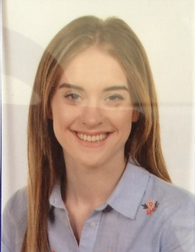
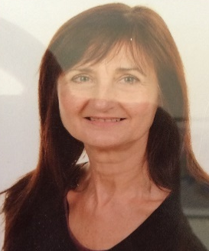
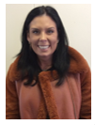
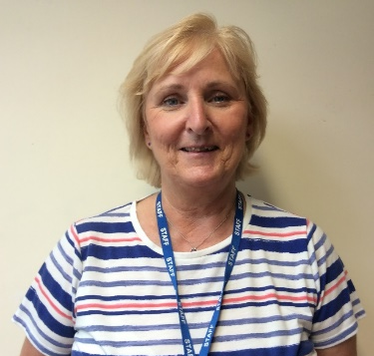
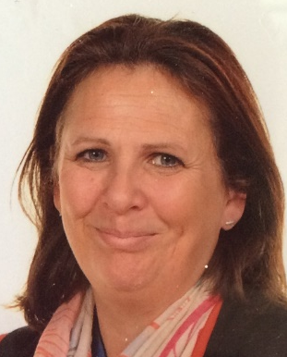
Meet our FABULOUS Reception team!
Miss Jones (Class Teacher) Full Time
Mrs Cawthorne
(PPA Teacher)
(Tues morning cover 9.10-12 noon)
Mrs Highmore (TA)
(Mon, Thurs and Fri Mornings)
Mrs Garvin
(TA)
(Tues, Wed, Thurs & Fri)
Mrs Fudge
(TA)
(Mon, Tues and Wed)

Slide 3
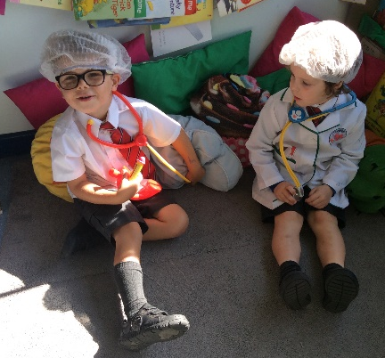
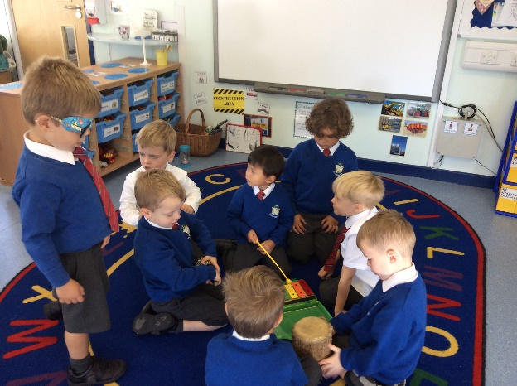
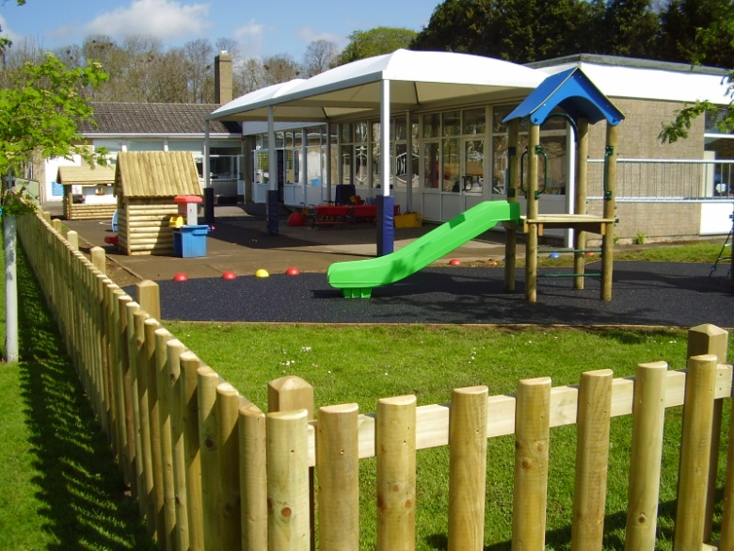
Learning in the Early Years Foundation Stage…
End of year goals
(7 Assessment areas)
Emerging
Expected
Exceeding
Personal, Social and Emotional Development.
Children will develop their skills in making relationships and thinking of others. They will be given opportunities to develop in confidence to try new things and speak in front of familiar groups. Children will think about other children’s feelings and how their behaviour affects situations.
Communication and Language
The goal is to develop children’s expressive language, encouraging children to show awareness of the listener. Children use past, present and future tenses when talking. They develop their own stories by connecting ideas and events.
2019 – 2020 Prime Subjects
Curriculum Web
Physical Development
Children will develop their control and co-ordination. Develop their awareness of space and they will be taught to use equipment and tools safely. Children will develop their understanding of health, exercise and hygiene.

Slide 4
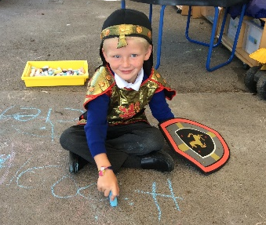
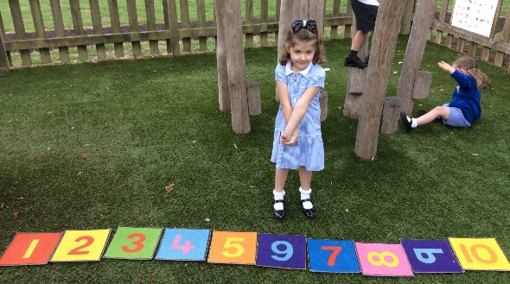
Learning in the Early Years Foundation Stage…
End of year goals
(Assessment areas)
Emerging
Expected
Exceeding
Literacy
Children will be taught to read and write using a knowledge and understanding of phonics. They will also be taught other skills such as reading and writing tricky words, using picture clues and context.
Mathematics
The goal is that children will be able to count from 0 – 20 and correctly order these numbers. That children will be able to say one more or less and add/subtract simple numbers.
Children will be taught to use this knowledge to solve simple problems. Children will develop their understanding of simple shapes, measures, patterns and use mathematical language to describe them.
Understanding the World
Children will be given opportunities to talk about past and present events in their lives and their families lives. They will listen to others and think about similarities and differences between themselves and others. They will learn about places, objects, materials, technology and living things. They will be given opportunities to discuss observations and changes that they notice.
2019 – 2020
Specific Areas
Curriculum Web
Expressive arts and design
Children will sing songs, make music and dance. They will experiment and experience tools and art materials. They will have opportunities to represent their ideas through a variety of mediums.
Notes:
Every child is a unique child, who is constantly learning and can learn to be resilient, capable, confident and self-assured;
Children learn to be strong and independent through positive relationships;
Children learn and develop well in enabling environments, in which their experiences respond to their individual needs and there is a strong partnership between practitioners and parents and/or carers; and
Children develop and learn in different ways and at different rates. The framework covers the education and care of all children in Early Years provision, including children with special educational needs and disabilities (SEND) .

Slide 5
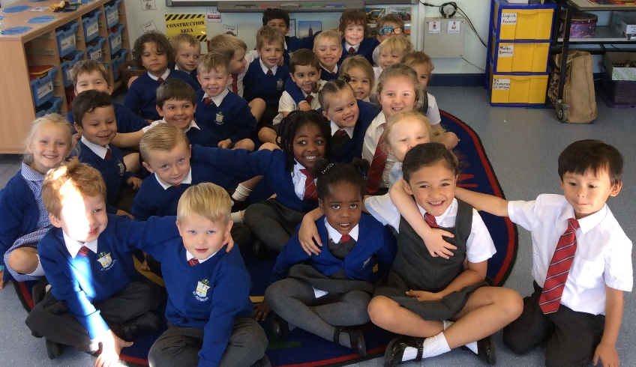
The School Day
First Half-term
8.40 am - The children self-register at the start of the day.
They go to the activities set out on the tables for ten minutes.
9.00 am - They gather on the carpet for register and prayers.
9.10 am – Phonics carpet session followed by phonic table activities to embed the new sound.
In term 1, a large proportion of adult-led teaching will be in small groups whilst either the class teacher or teaching assistant will be developing child-led play activities. Whole class teaching will develop throughout the year to prepare the children for Year One and the National Curriculum.
10.00 am – Circle time for snack time.
10.20 am - The children go out to play with the whole school.
10:40 am - Children will take part in whole class maths lesson and child-led activities.
12.00 am - Lunch time.
1.00 pm - After lunch the children will continue with both adult-led and child-led activities.
2.40 pm – Collective Worship/ Show and Tell/ Story and news time.
3.05 pm – Home time.

Slide 6

Well-being and Mental Health
Daily Run
Circle time
ELSA
Year Five Buddies
PSHE
Forest School
Mindfulness
Kindness Acts
Notes:
Mental health problems affect about 1 in 10 children and young people. They include depression, low self esteem and anxieties.
Good mental health allows children and young people to develop the resilience to cope with whatever life throws at them and grow into well-rounded, healthy adults.
To help develop children’s well-being and keep them mentally well, we offer a range of activities at ST Pats.

Slide 7





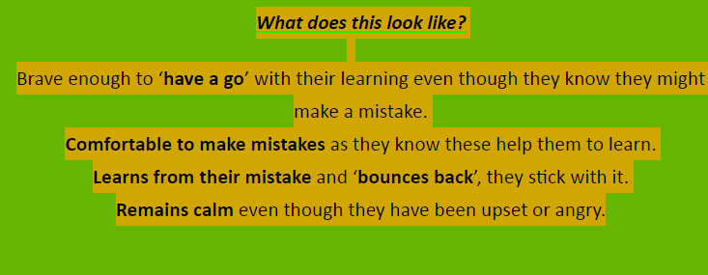
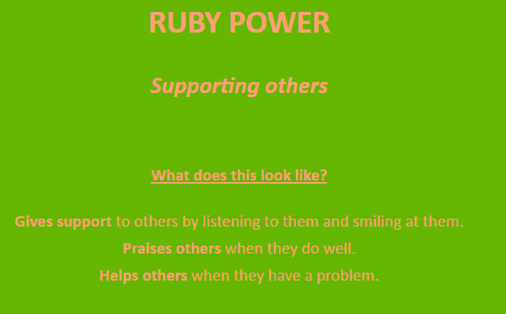
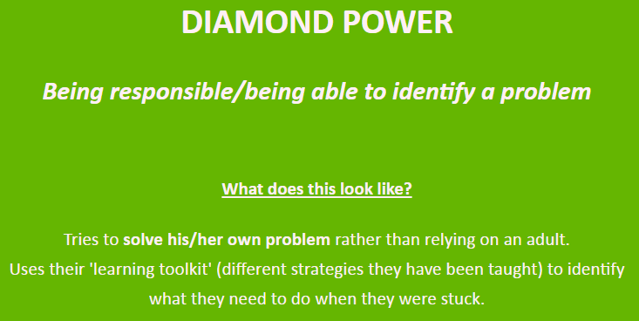
Learning to be Learners
Gem Project
The Gem Project is an approach to teaching Learning Behaviours, developed by educational advisor Dr Tom Robson. We want our children to have a passion for learning and to develop a range of skills to support learning in school and in everyday life.
http://www.stpatricks-wilts.co.uk/topic/learning-to-learn-the-gem-project

Slide 8
Reception Information
Please arrive in class from 8:40am. Doors will close at 8.55.
Please ensure reading folders are put into the coloured tray that matches your child’s locker (we will not change books if they are not in the tray).
P.E will be on Wednesday afternoons and Thursday mornings. However, this can change so please leave PE kits in school!
Welly walks will be on throughout the year so please look out for the notices. Wellies are really useful to have in school at all times so please leave a cheap pair in school if you can.
Any money should be put in an envelope with the child’s name and explanation on the front. Children should not be carrying change in their school uniform.
Please name all items (bottles, jumpers, daps, etc)! Encourage your child to dress/undress for school and the weekend. Celebrate the independence skills they are showing.
If you would like your child to have milk at break time please order online. Please order dinner at least 2 weeks in advance.
We have a book shop at St Patrick’s school (open on Tuesday). The amount is between 50p and £1, the children collect stamps on their card and when they have enough they can choose a book to buy. Please put any money in a named envelope.
Golden assemblies will take place on Fridays, we will inform you if your child has been chosen for the Golden Book.
Please contact the school regarding any absences.
Please let us know if someone different is picking up your child.
Please inform us with any new medical information about your child.
If you would like to speak to us about anything please see us either first thing or after school.

Slide 9
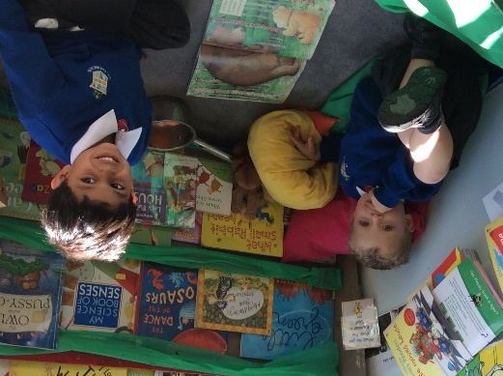
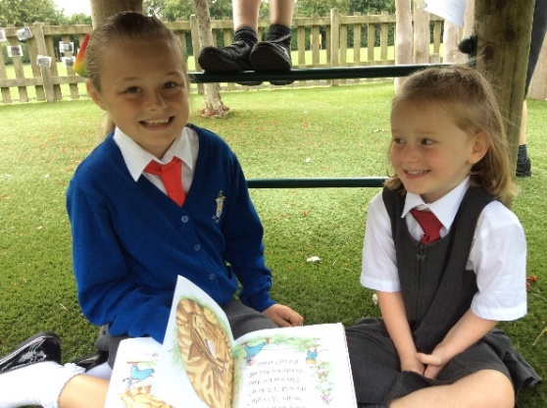
Reading at Saint Patrick’s
Picture Books
Picture books are there to support your child’s comprehension skills. Your child will talk about the pictures and answer questions about what they can see.
Skills: comprehension, prediction, routine and language development.
Books with Words
Encourage him/her to sound it out and then blend the sounds together to make the word.
Look for clues in the pictures or context of the sentence.
Tell your child the word and go back later to check he/she can remember it.
Skills: blending and segmenting words, reading tricky words, comprehension, prediction and language development.
Read for pleasure
Our first aim is to generate a passion for reading! Reading doesn’t always have to be the school book but can be own stories at home, menus, magazines, newspapers- anything that your child wants to read. Our first aim is to generate a passion for reading so read anything. Just please make a note in record books so that it can be acknowledged and discussed with your child.
It is important to make reading an enjoyable experience, let your child hold the book and find a comfortable place for reading to take place!

Slide 10

Phonics….
Phonics takes place daily within the Reception classroom. Phonics teaches children to be able to listen carefully and identify the sounds that make up each word.
The children learn to recognise and say letter sounds. There are 44 sounds which children need to learn.
They then learn the skills of blending and segmenting.
Blending (reading)
This is when children say the sounds that make up a word and are able to merge the sounds together until they can hear what the word is. This skill is vital in learning to read.
Segmenting (spelling)
This is the opposite of blending. Children are able to say a word and then break it up into the phonemes that make it up. This skill is vital in being able to spell words.
REMEMBER: Children learn at different rates. Children will be taught at their level and pace and may not pick up phonics straight away.
We use a mixture of phonic schemes which consist of‘Letters and Sounds’ and ‘Jolly Phonics’.

Slide 11
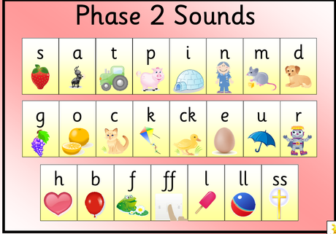
Phase 2
Children will learn to ‘sound-talk’ (Fred talk).
Children will be taught basic phonemes (sounds). These phonemes will mostly have 1 letter and a few with 2 letters.
Children will be taught to blend phase 2 words (reading).
Children will be taught to segment phase 2 words (spelling).
Check the notice board each week to find out the sounds we are learning!

Slide 12
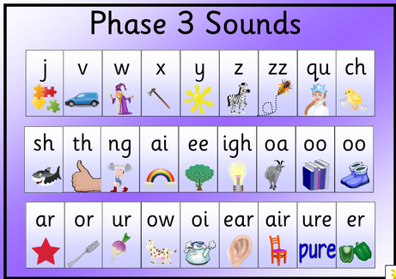
Phase 3
Children will be taught the last few phonemes with 1 letter and develop their knowledge of phonemes with 2 letters. Two letters that make one sound are called digraphs. Three letters that make one sound are called trigraphs.
Children will be taught to blend phase 3 words (reading).
Children will be taught to segment phase 3 words (spelling).
If you are unsure on how to pronounce the sounds, that we have displayed, please don’t hesitate to ask any of the Early Years Team!
Phonicsplay.co.uk and YouTube are really helpful sources e.g. ‘Mr Thorne Does Phonics’ on YouTube.
What can you do to support your child?
Encourage your child to ‘sound out’ when reading or writing. Focusing particularly on spotting more unusual sound patterns.
Encourage your child to use a sound mat when writing to find the sound they need.
Play games! www.phonicsplay.co.uk
Remember phonics is not the only thing needed to be a fluent reader!
https://www.youtube.com/watch?v=IwJx1NSineE 37 sec

Slide 13

Parents as Learning Partners
What can you do to help your child?
Meal times as a family, talk, talk, talk, talk…
Encourage your child to use a knife and fork/dress themselves etc.
Go to an art gallery, a museum, a bus, a train…
Writing with lots of
Different materials.
Send a post card.
Library visits.
Count everything!
enjoy stories, poems and
number nursery rhymes
Simple Simon says…
Pay with coins in a shop.
Spotting sounds, words and numbers in the local environment.
I spy with my little eye.
Can you write the shopping list for your family?

Slide 14
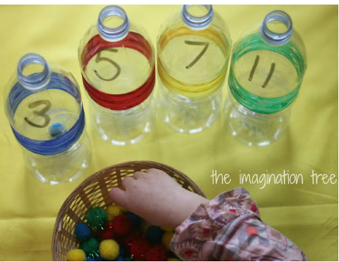
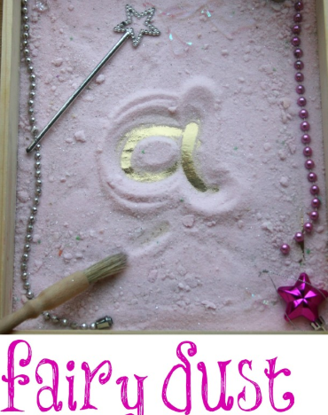
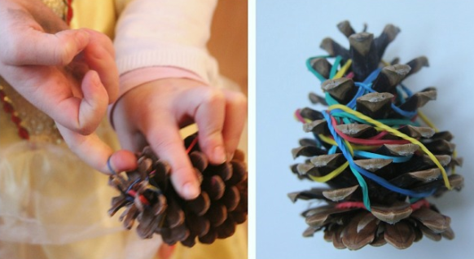
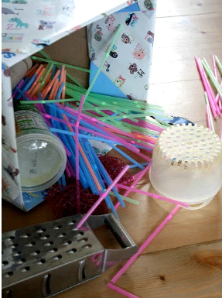
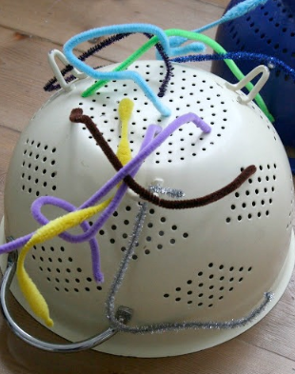
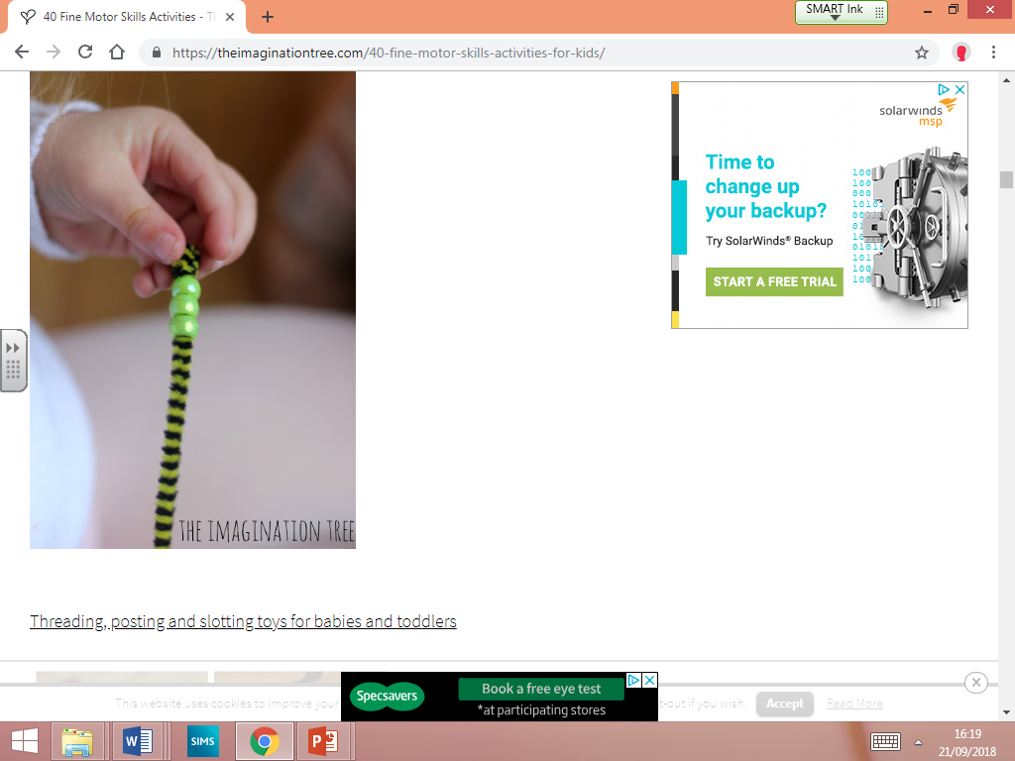
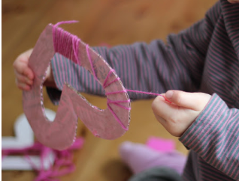
Fine Motor Development is KEY!
Especially for reluctant writers
Poking straws into holes
Threading

Slide 15
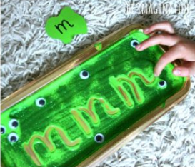
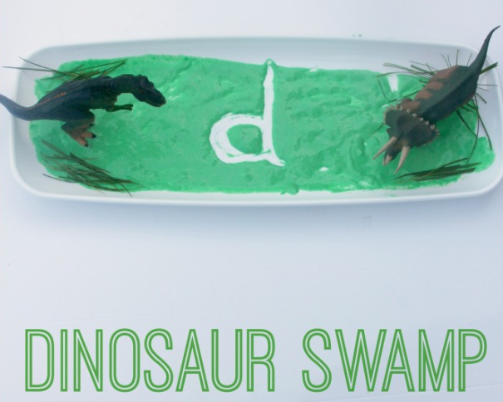
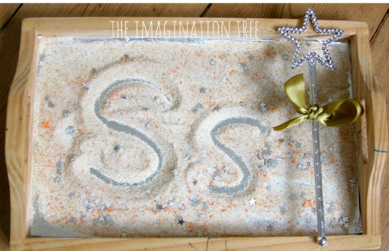
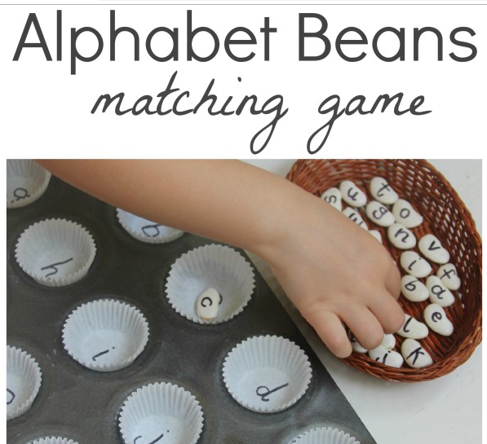
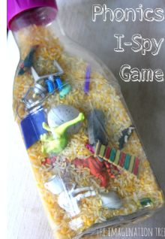
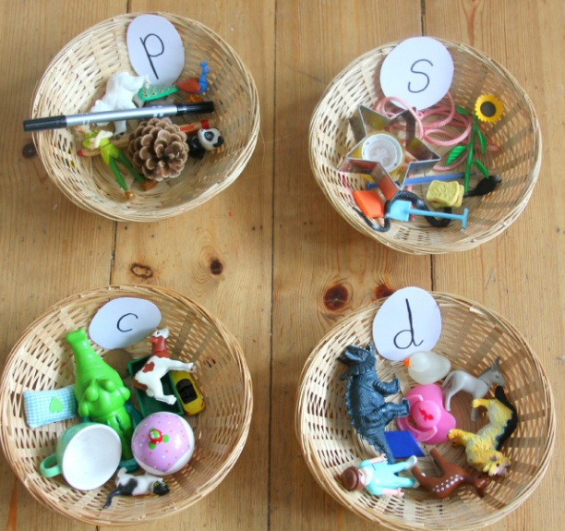
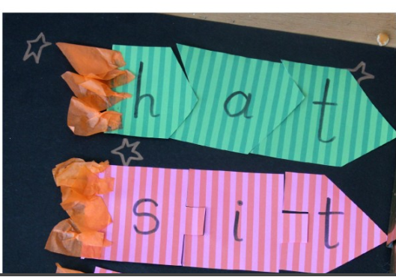

Slide 16
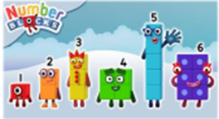
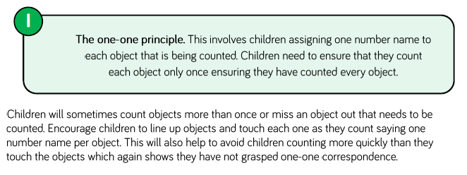

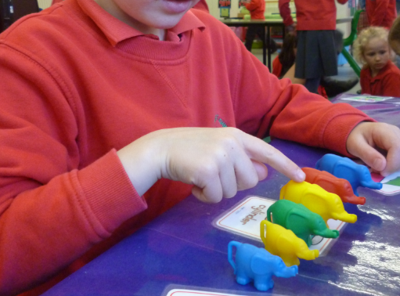
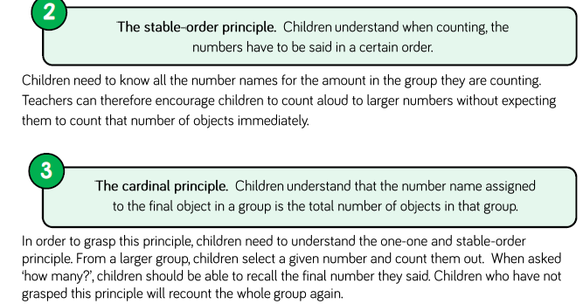


Maths
The 5 principles of counting in EYFS!

Slide 17

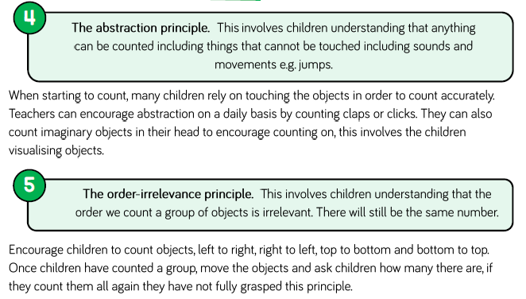
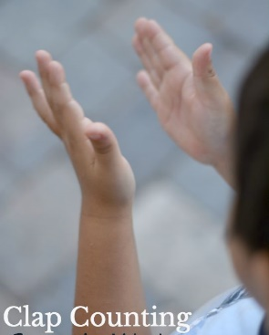
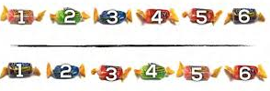
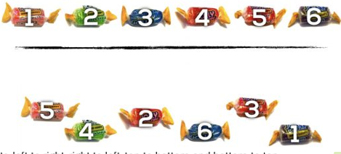
Maths
The 5 principles of counting in EYFS!

Slide 18
Home Learning
Monday – Reading book to go home
(return the following day)
Tuesday – Library/Classroom Book to go home
(return the following day)
Wednesday – Reading book to go home
(return the following day)
Thursday – Phonics or Maths Home learning and an enrichment activity (return the following Tuesday).
Friday – Reading book to go home
(return Monday)
Thursday’s home learning folder needs to be put in the box under the display board (in corridor) by the following Tuesday.
Acknowledgement of parent feedback.
Supporting the learning that naturally goes on at home.
Chance to practice skills, e.g. phonics, using scissors, counting, getting dressed independently, etc.

Slide 19
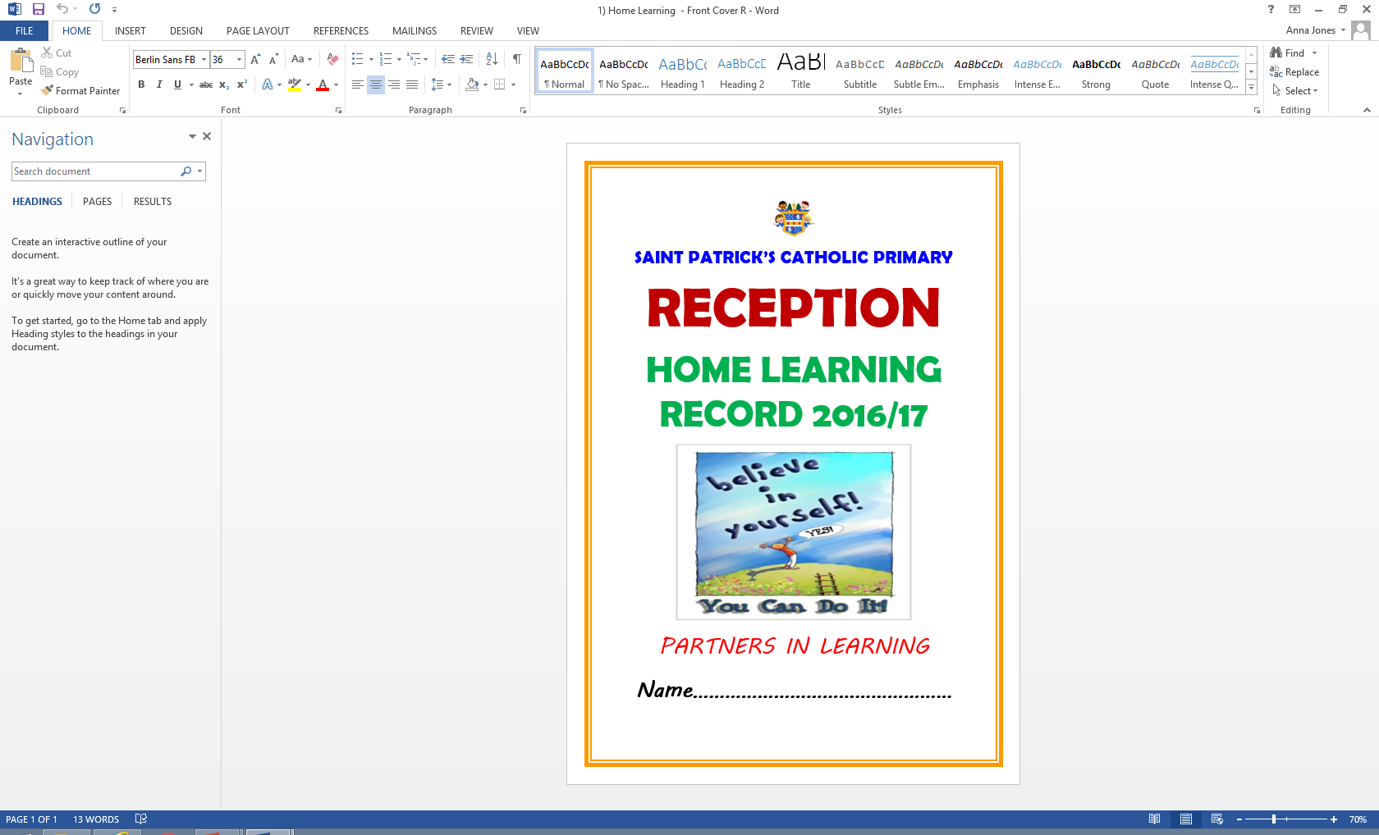
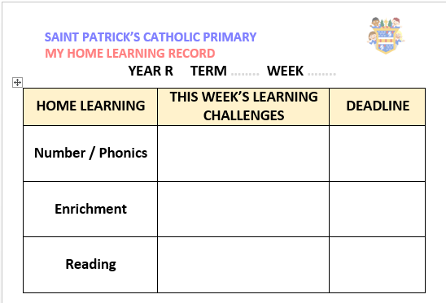
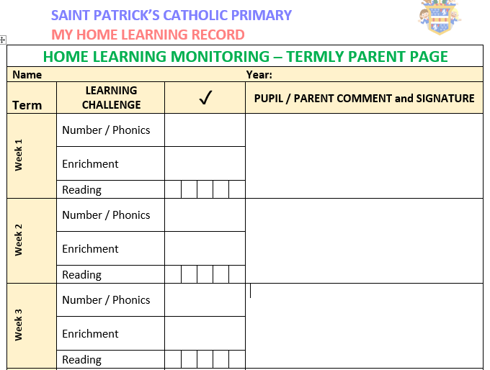
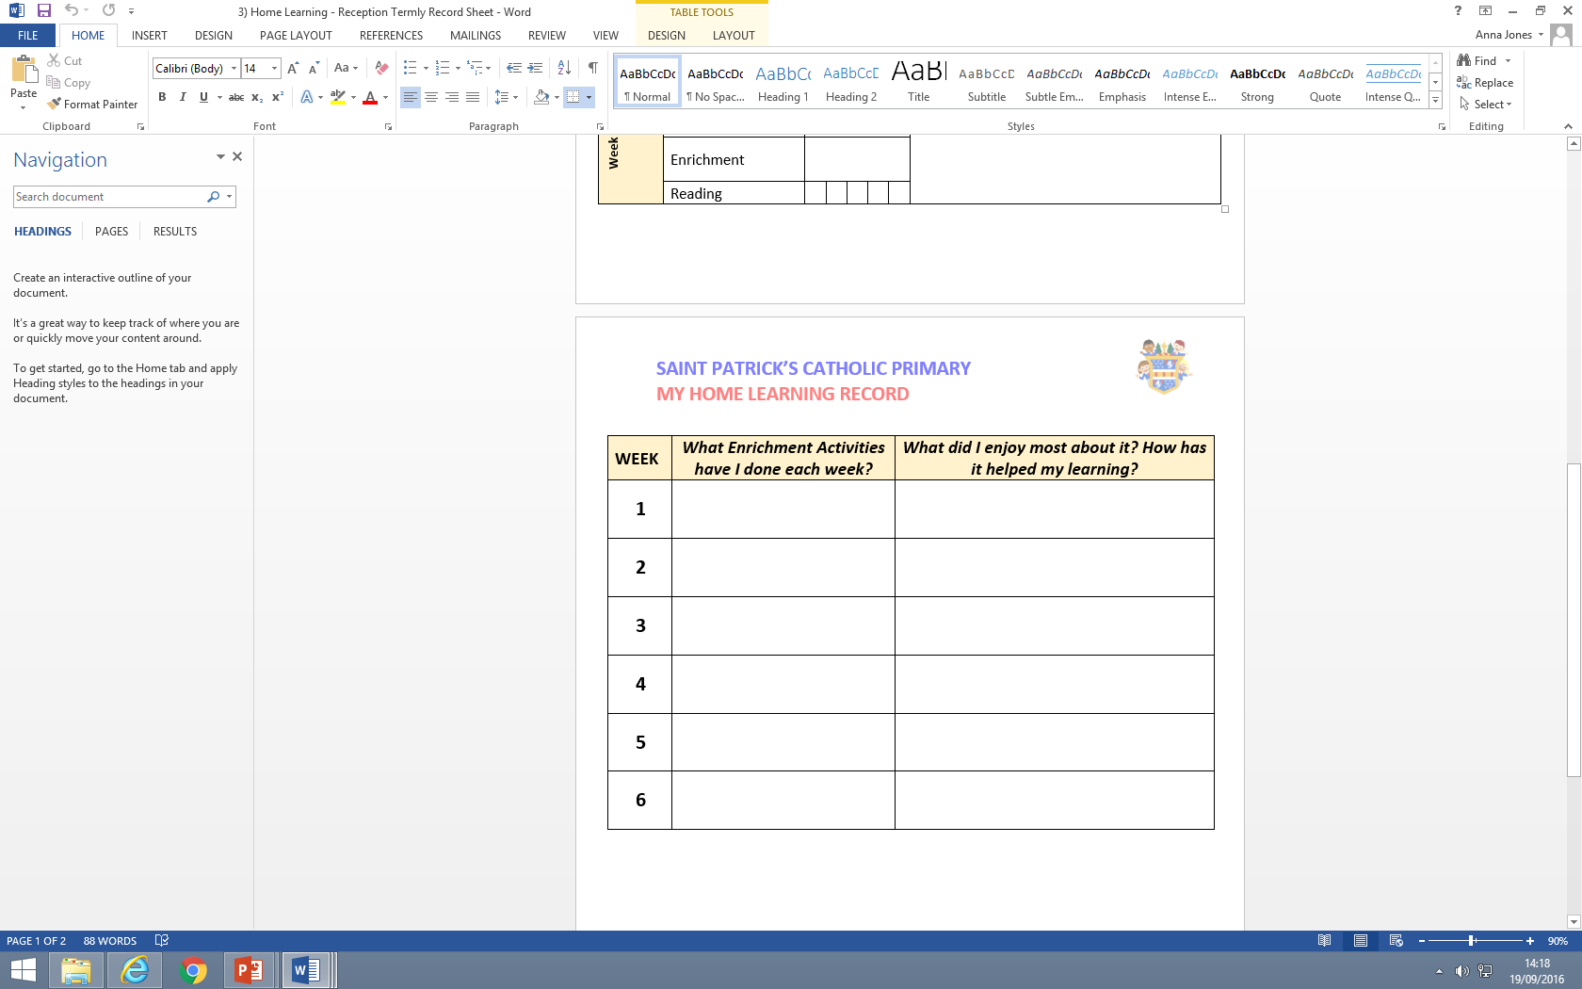
Home Learning Record

Slide 20
Home and School working together
Wow Board- photos or records of special achievements at home can be displayed on our wow board. E.g.-drawings, stories, certificates, first bike ride etc.
Wow Moments –through the year we will send out wow post-it notes. Please add any remarkable or noteworthy achievements.
Learning Journals are a photographic and written record of your child’s learning journey. You will have the opportunity to look and add to it through the year.
Parent Mail- make sure the office has your up to date details to ensure you receive school letters/messages.
Please see the St Patrick’s website-check the web page and Reception pages for extra information.
Check the noticeboard regularly for notices and updates.
At St Patricks’ we offer: Curriculum afternoons, Parents’ Evenings in October / March, Annual Records of Achievement, Termly Assessment, Parent Information evenings, Learning Journals, Red Assessment Books (spring) and Informal conversations.

Slide 21
Reminders…
Have you got anytime spare to help the Reception class? This could be gardening, reading, art & craft – let us know your strengths and interests!
Look out for the Golden Assemblies in the newsletter.
Please volunteer to help on welly walks which will most likely be on Thursday afternoons.
KS1 Nativity
Reception First Class Assembly will be Mid January (no date yet).

Slide 22
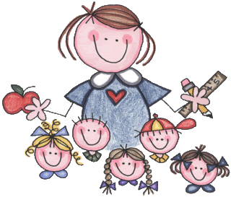
Thank you for listening!
Any questions?

