Slide 1

Colours of Day
What image does this picture suggest?
What story from the Bible might this song be about?
Colours of day dawn into the mind

Slide 2
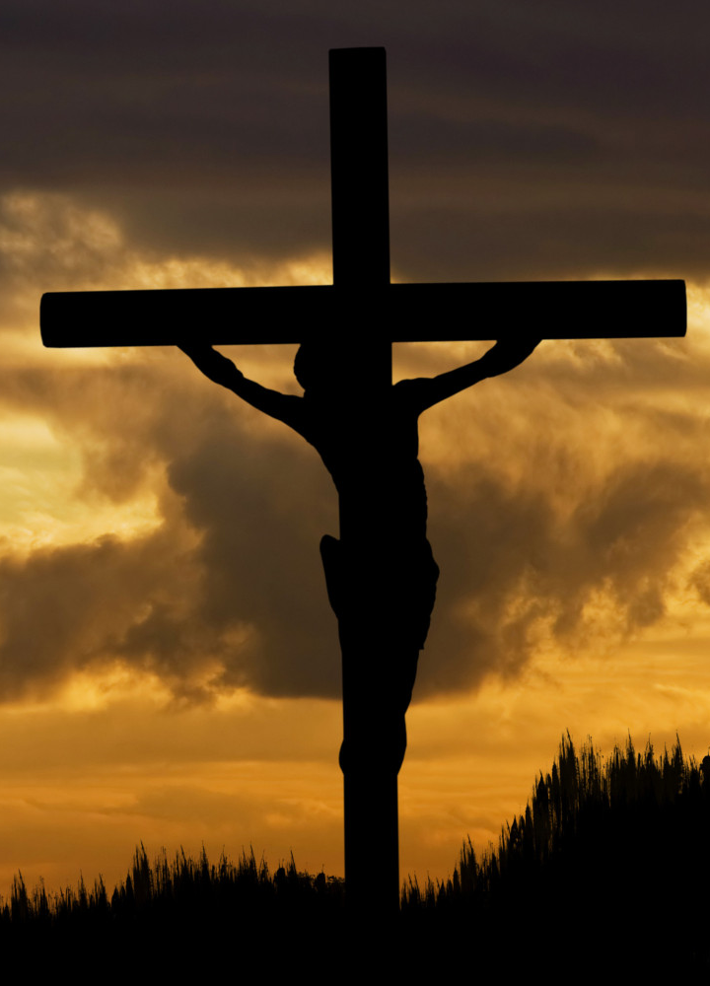
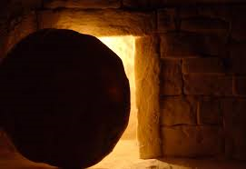
The sun has come up, the night is behind.
What two events are shown here?
Which one do you think is night and which one day? Why?

Slide 3
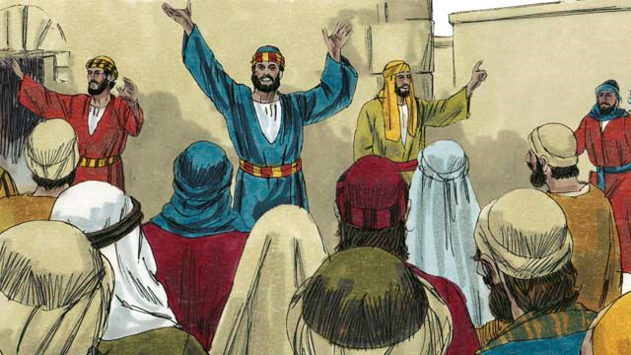
Go down in the city, into the street,
And let’s give the message to the people we meet
Who do you think is in this picture?
When do you think it is and what message might they be giving?

Slide 4

So light up the fire and let the flame burn
Open the door let Jesus return
When did the flame burn?
What effect did this have on the disciples?

Slide 5
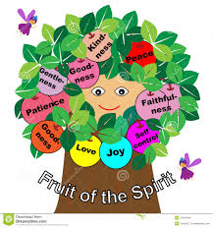
Take seeds of his Spirit, let the fruit grow,
Tell the people of Jesus, let his love show
How many fruits of the Holy spirit can you count ? This is St Paul’s list
Do you know what each of the words mean?
Which one of these fruits do you need in your life?

Slide 6
