Slide 1
ALL ARE WELCOME
MY FAVOURITE HYMN
By Mabel

Slide 2
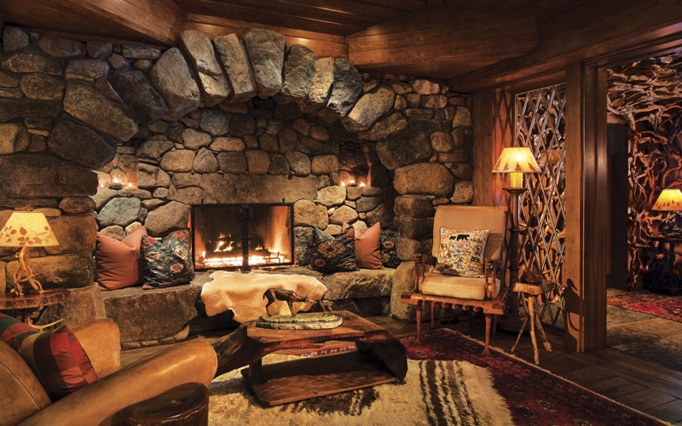
Let us build a house
Where love can dwell
And all can safely live,
A place where
Saints and children tell
How hearts learn to forgive.

Slide 3

Built of hopes and dreams and visions,
Rock of faith and vault of grace;
Here the love of Christ shall end divisions;

Slide 4
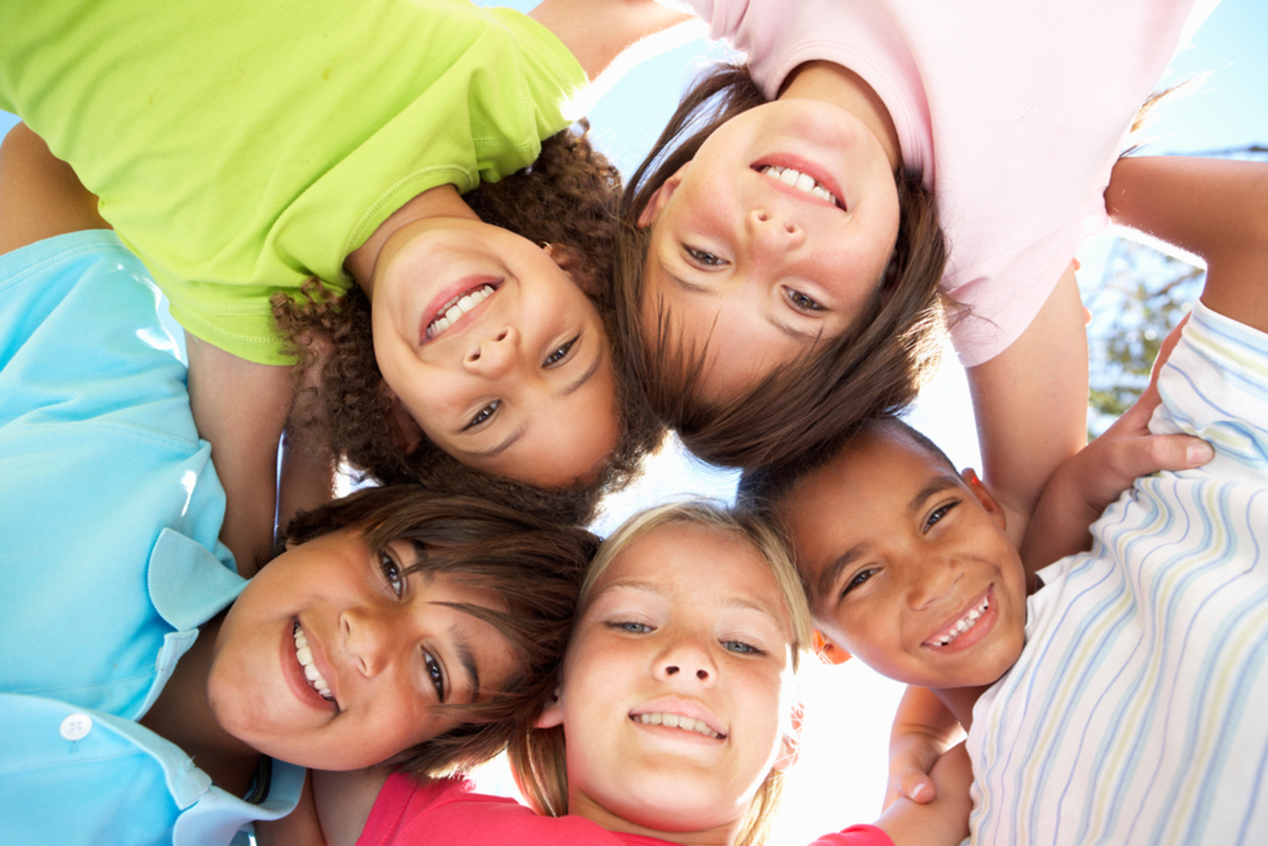
Let us build a house where prophets speak,
And words are strong and true,
Where all God's children dare to seek
To dream God's reign anew.
This Photo by Unknown Author is licensed under CC BY-ND

Slide 5

Here the cross shall stand as witness
And a symbol of God's grace;
Here as one we claim the faith of Jesus:
This Photo by Unknown Author is licensed under CC BY-NC-ND

Slide 6
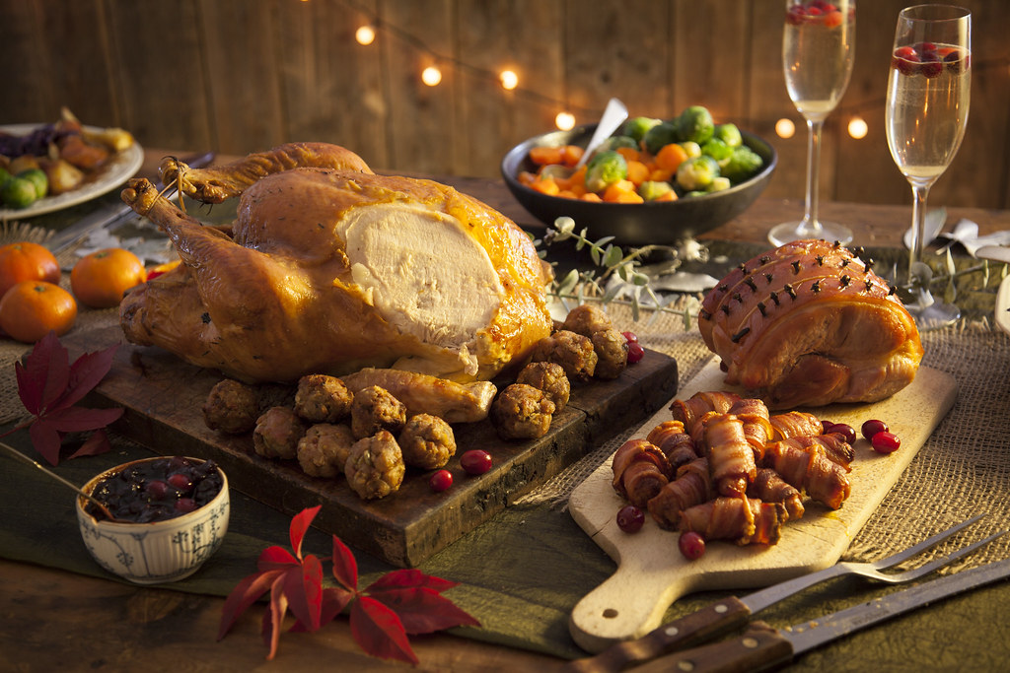
Let us build a house where love is found
In water, wine and wheat:
A banquet hall on holy ground,
Where peace and justice meet.

Slide 7
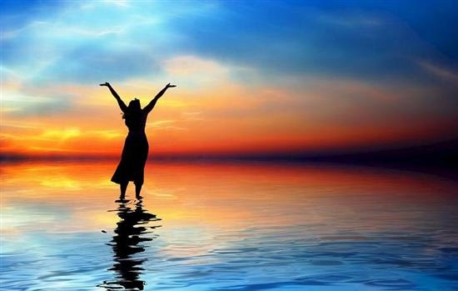
Here the love of God, through Jesus,
Is revealed in time and space;
As we share in Christ the feast that frees us:

Slide 8

All are welcome, all are welcome,
All are welcome in this place.

