Slide 2
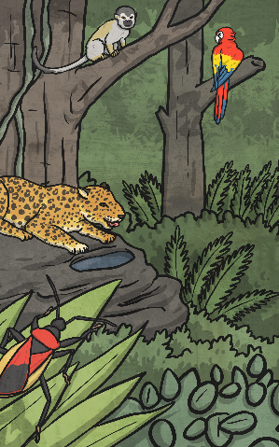
What are Rainforests?
Rainforests are very dense, warm, wet forests.
They are habitats for millions of plants and animals.
Rainforests are very important in the ecology of the earth. The plants of the rainforest produce most of the earth’s oxygen.

Slide 3
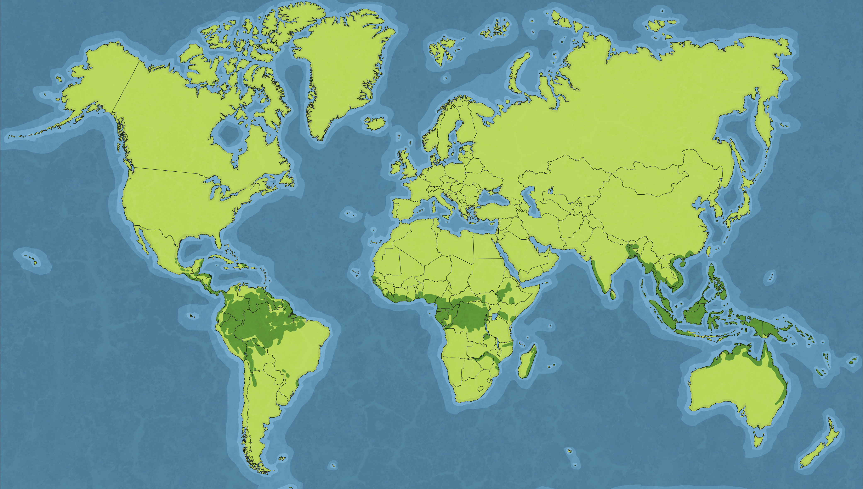
Where are the Rainforests?
Tropical rainforests are found in a belt around the Equator of the Earth.
There are tropical rainforests in:
South East Asia
Central America
Africa
South America
Australia

Slide 4

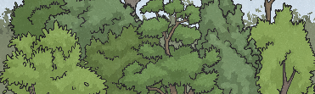
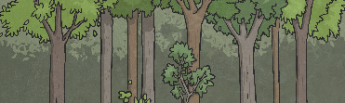

Layers of the Rainforests
Emergent Layer – these are the tallest trees in the rainforest and can reach 70 metres tall. They have huge leafy crowns that spread out to catch as much sunlight as possible.
Canopy – This is the dense leafy layer with trees about 40 metres tall. They spread their branches out to catch most of the sunlight and rain. This is the most popular place to live in the jungle.
The Understorey – Leafy bushes and small trees entwined with vines make up this layer. It is dark and hot here. Many animals cross between this layer and the canopy above and many are nocturnal.
Forest Floor – A carpet of dead leaves forms the base of this dim and shady layer. The lack of sunlight means fewer plants grow here.

Slide 5
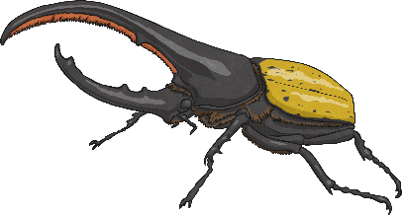
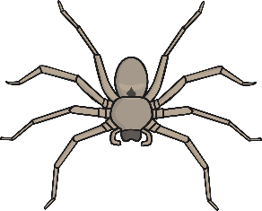
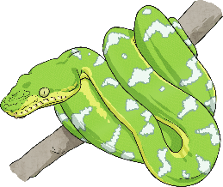
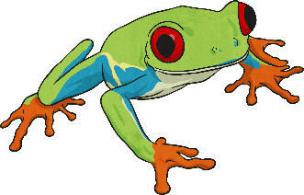
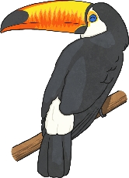
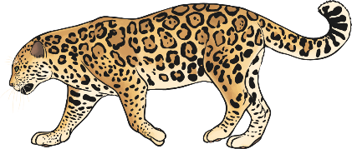
Animals in the Rainforests
Rainforests are home to a variety of different animal species
Insects
Arachnids
Reptiles
Butterflies and Beetles
Spiders and Ticks
Snakes and Lizards
Amphibians
Birds
Mammals
Toads and Frogs
Parrots and Toucans
Apes and Jaguars

Slide 6
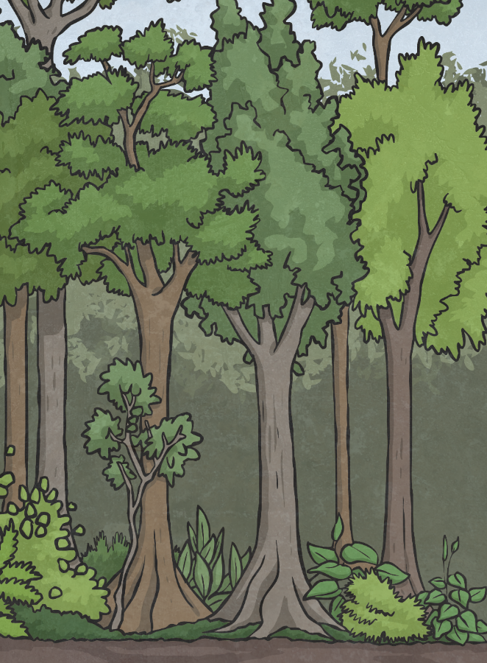
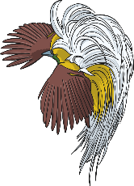

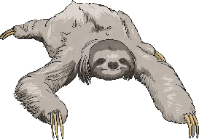
Different animals live in different layers of the rainforest
Birds live in the canopy layer and the emergent layer.
Insects are found almost everywhere. The Morpho butterfly lives in the canopy and has a wing span of 18cm.
Large animals like jaguars generally live on the forest floor, but others like monkeys and sloths are more arboreal.
Meaning of Arboreal – living in trees

Slide 7
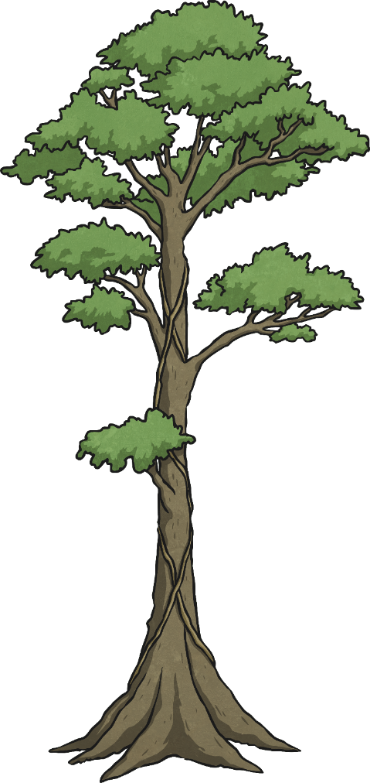
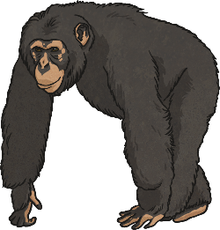
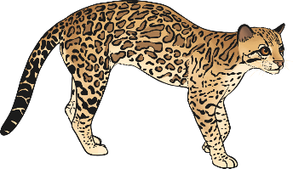
Different animals live in different layers of the rainforest
Many birds live in the emergent layer. They look for nesting places and are away from predators.
The understorey layer gets little light and is home to many animals like frogs, bats, apes and owls.
The forest floor is home to many insects, spiders and large animals like jaguars and ocelots.

Slide 8
What are the different layers in a rainforest?
Can you draw a picture and label the different layers of the rainforest?
Can you add some animals into the right layers of the rainforest?
What can you find out about the different plants in a rainforest? What can you find out about a Kapok tree?

