Slide 1

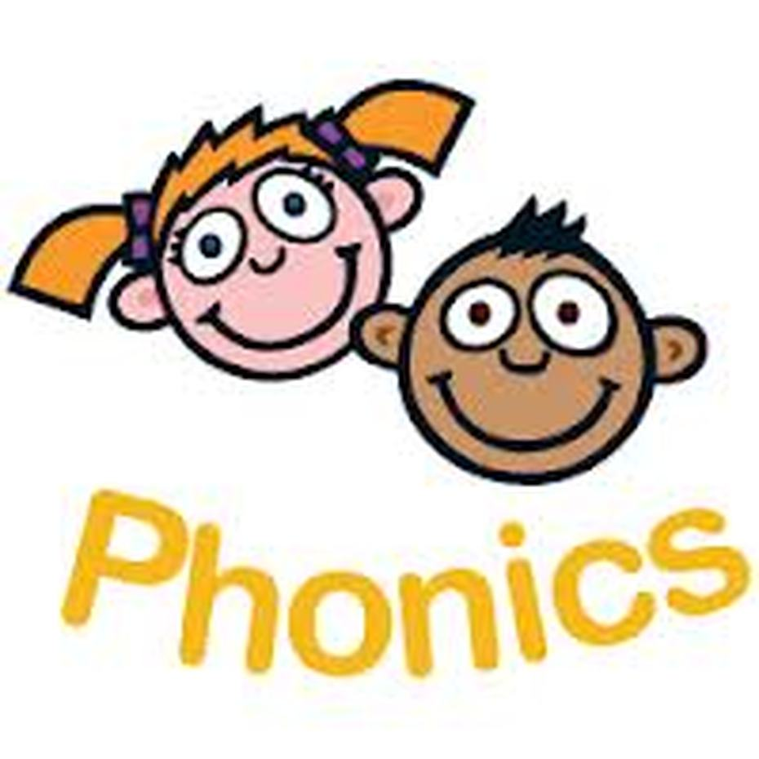
Phonics Test Workshop
Summer Term 2016

Slide 2
What is phonics?
Phonics is how your child learns to read and write.
Children are taught basic letter sounds and alternative letter sounds.
The children are taught to read the sounds in words using sound-talk and to blend these sounds to decode words.
They are taught to segment the sounds in words using sound-talk and write the sounds that they can hear.
The children are taught to read and write tricky words.

Slide 3
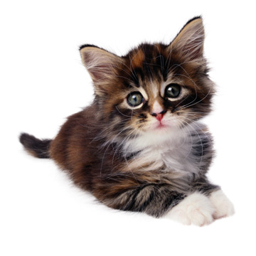
What is a phoneme?
A phoneme is the smallest sound in a word
How many sounds in cat?
C A T
. . .

Slide 4
Phase 5
Overview: By end of phase children will broaden their knowledge of graphemes and phonemes for use in reading and spelling.
Introduce graphemes: ay, ou, ie, ea, oy, ir, ue, aw, wh, ph, ew, oe, au, a-e, e-e, i-e, o-e, u-e.
Split digraphs:
Decode these HF words that include a split digraph: like, make, came, made
Teach these tricky words: oh, their, Mr, Mrs, looked, called, asked, would, should, could, water, where, who, again, thought, through, work, mouse, many, laughed, because, different, any, eyes, friends, once, please.
What can you do at home?
Continue to play games practise the tricky words read

Slide 5
Example of Phonics Lesson by Miss McCarthy

Slide 6
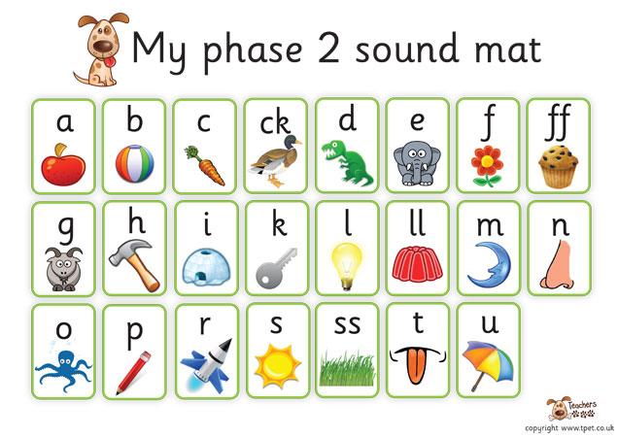
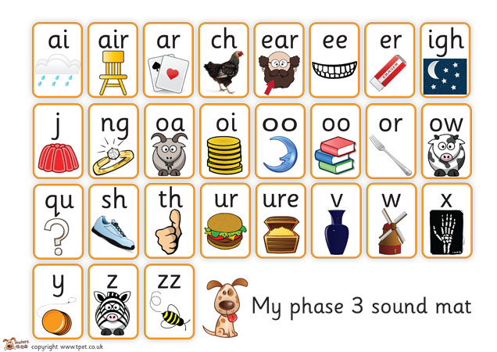
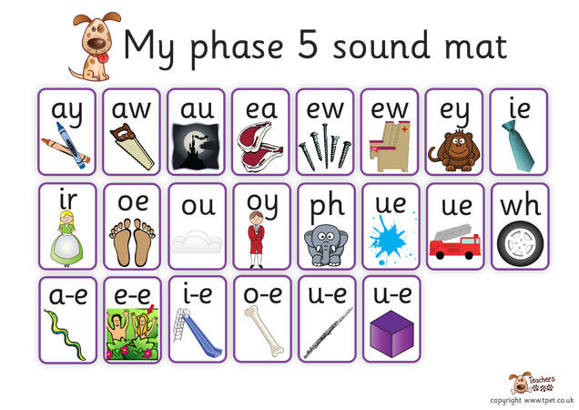

Slide 7
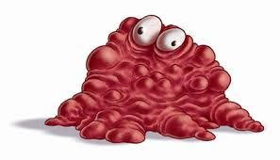
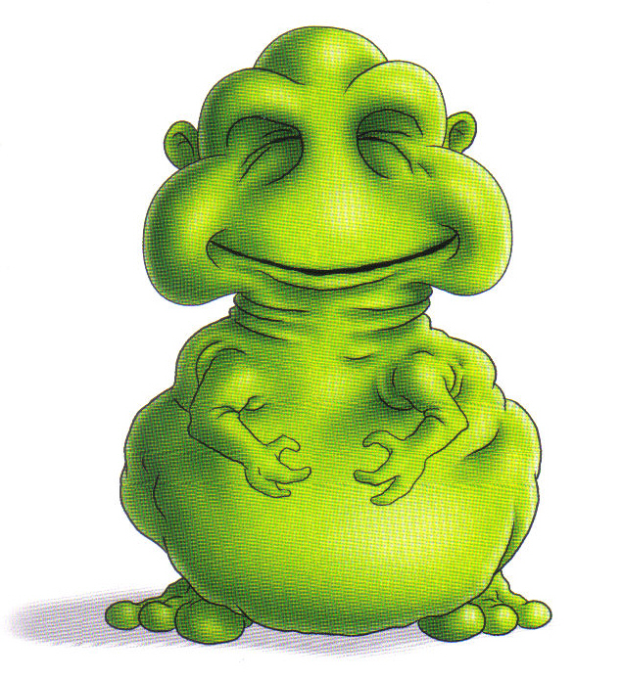
glairm
poit

Slide 8
Read the key words with a friend
called didn’t school we

Slide 9
Teaching the New Sound
Then I introduced the new sound or alternative spelling for the lesson, there will be picture clues for the children to work out the sound or alternative spelling.
We discuss the sound/alternative spelling in the words
Watch a video teaching us more about the sound.

Slide 10



Slide 11



Slide 12
Phonics Test
What is expected of the children?
The check is very similar to tasks the children already complete during phonics lessons.
Children will be asked to ‘sound out’ a word and blend the sounds together.eg d-o-g - dog.
The focus of the check is to see which sounds the children know and therefore the children will be asked to read made up ‘nonsense’ words. Zong, Phrang and zog are all examples.

Slide 13
Phonics Test
The Test will happen this term.
Parent Oath! Please do not ask your children every day whether they have had a test….. They will not know that it is a test.
1:1 with teacher

Slide 14
Key Points
All children learn at different rates. They will be taught the phase that is most appropriate for them.
Phonics doesn’t stop in Year 2. Children will continue to learn at the appropriate phase and when ready move onto spelling rules.
The children who haven’t ‘passed’ the phonics test will informally do it again in year 2 so that the teachers are aware of developments.

Slide 15
What can you do to support your child?
Encourage your child to ‘sound out’ when reading or writing. Focusing particularly on spotting more unusual sound patterns. E.G spine and night.
Encourage your child to use a sound mat when writing to find the sound they need (in the back of your pack).
Play games! www.phonicsplay.co.uk
Remember phonics is not the only thing needed to be a fluent reader!
The most important thing is to ENJOY READING!

Slide 16
Thank you for Attending our Phonics Test Workshop

