Slide 1
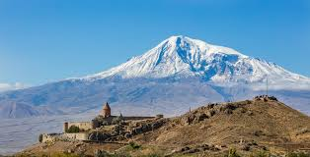
We three kings of orient are
Bearing gifts we traverse afar
Field and fountain
Moor and mountain
Following yonder star

Slide 2
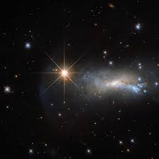

O star of wonder, star of night
Star with royal beauty bright
Westward leading, still proceeding
Guide us to thy perfect light

Slide 3
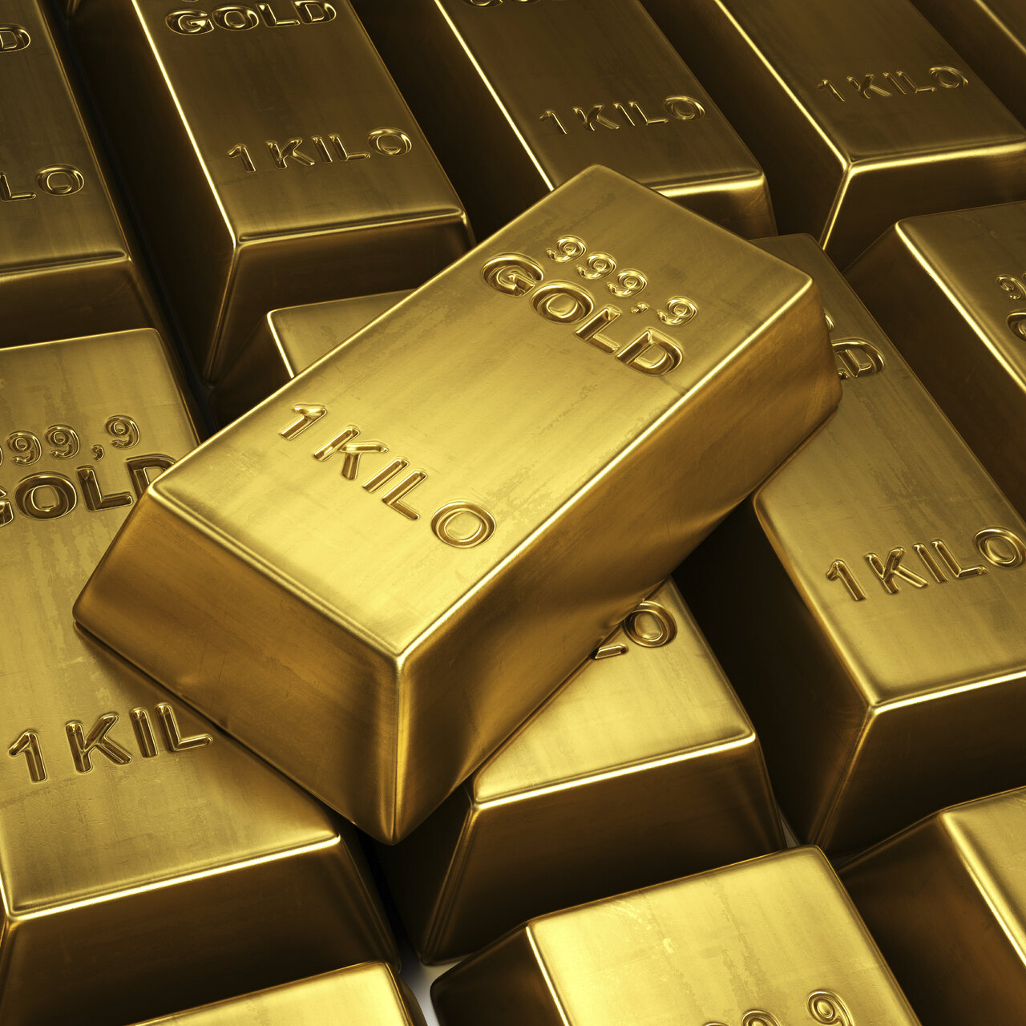
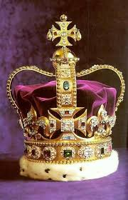
Born a King on Bethlehem's plain
Gold I bring to crown Him again
King for ever, ceasing never
Over us all to reign

Slide 4
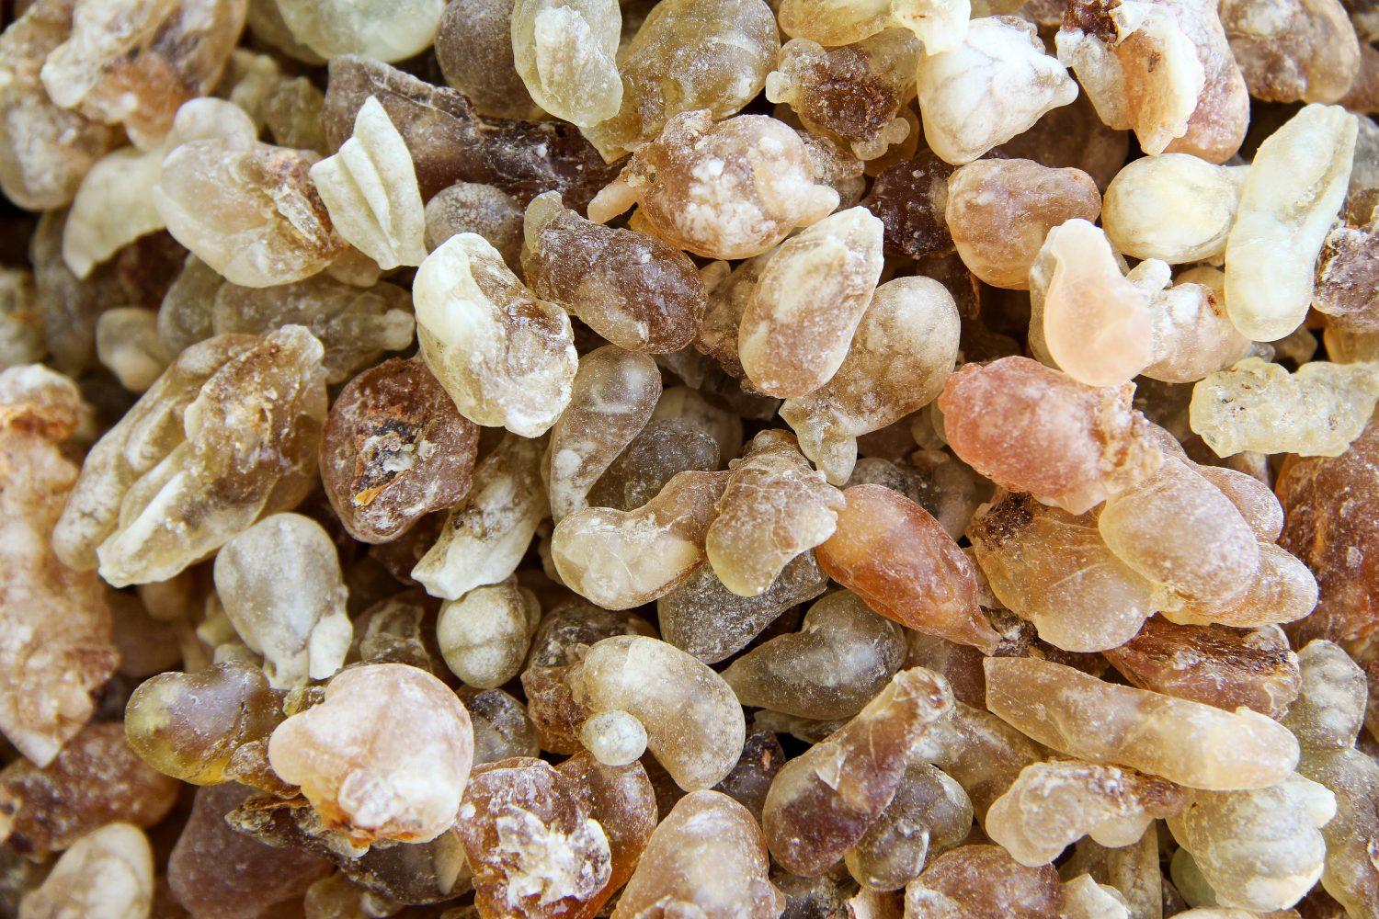
Frankincense to offer have I
Incense owns a Deity nigh
Prayer and praising
All men raising
Worship Him, God most high

Slide 5
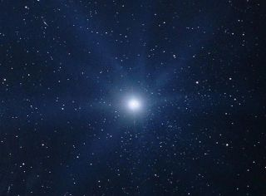
O star of wonder, star of night
Star with royal beauty bright
Westward leading, still proceeding
Guide us to thy perfect light

Slide 6
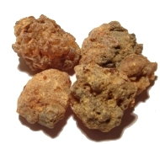
Myrrh is mine; its bitter perfume Breathes a life of gathering gloom
Sorrowing, sighing,
Bleeding, dying,
Sealed in the stone-cold tomb.

Slide 7
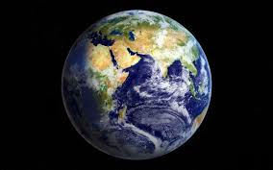
Glorious now behold Him arise,
King, and God, and Sacrifice;
Heav’n sings Hallelujah:
Hallelujah the earth replies.

Slide 8
